Slide 1

Commodity dependence and economic development
Division on International Trade and commodities
Commodities Branch
30 April 2019, Geneva
Janvier D. Nkurunziza
Commodities Branch, UNCTAD

Slide 2
Outline
Recent developments in global commodity markets
What is a commodity and what is commodity dependence?
From dependence to development: transmission channels
Managing commodity price risk
Lessons and the way forward

Slide 3
Definitions and discussion

Slide 4
Commodities in international trade
Total trade
Merchandise
Services
Commodities
Manufactured

Slide 5
Defining the 'commodity' concept
According to non-specialized dictionary:
  Something useful or valuable
  A raw material or agricultural product that can be bought and sold
Specialized definition (GATT, Article XVI, Section b):
Commodity or 'primary product is understood to be any product of farm, forest, or fishery, or any mineral, in its natural form or which has undergone such processing as is customary required to prepare it for marketing in substantial volume in international trade'

Slide 6
What are we talking about?
A wide range of products classified in following broad categories:
  Food (e.g. wheat, maize, rice, soybeans)
  Tropical beverages (coffee, cocoa, tea)
  Agricultural raw commodities (e.g. cotton, rubber, timber)
  Minerals, ores and metals (e.g. iron ore, gold, copper)
  Energy
    Traditional: oil and gas
    Green: solar, wind, geothermal

Slide 7
What are we talking about?
In SITC (Standard International Trade Classification):
  Primary commodities
  Precious stones
  Non-monetary gold
These are SITC 0 +1+2+3+4+68+667+971

Slide 8
UNCTAD Commodity price index
ALL FOOD
- Food
Wheat
Maize
Rice
Sugar
Bovine meat
Bananas
Pepper
Soybean meal
Crustaceans*
Fish*
- Tropical beverages
Coffee
Cocoa beans
Tea
- Vegetable oilseeds and oils
Soybeans
Soybean oil
Sunflower oil
Groundnut oil
Copra
Coconut oil
Palm kernel oil
Palm oil
AGRICULTURAL RAW MATERIALS
Fish meal fodder*
Tobacco
Cotton
Wool
Jute
Hides and skins
Tropical logs
Tropical sawnwood*
Plywood*
Rubber
MINERALS, ORES AND METALS
- Minerals, ores and non-precious metals*
Phosphate rock
Manganese ore
Iron ore
Aluminium
Copper
Nickel
Lead
Zinc
Tin
Tungsten ore
- Precious metals*
Gold*
Silver*
Platinum*
Fuels*
Natural gas*
Coal*
Crude petroleum*

Slide 9
Many actors involved in commodity value chain:
  Farmers and other producers
  Governments
  Investors
  Shippers/Transporters
  Logisticians
  Financiers and insurers
  Manufacturers
  Speculators
  Regulators (national and international)

Slide 10
Complexity of Commodities trade
Example of petroleum value chain:
  Produced in country A by a multinational corporation with a local state company, and bank funding
  Sold to another multinational corporation with finance from bank
  Stored in country A before shipping to buyer
  Shipped to buyer's country or specified destination with financing from bank
  Stored in importer's country using importer's infrastructure
  Refined by importer in her refineries
  Sold to big retail companies (e.g. Migros)
  Distributed to petrol stations across the country
  Insurance companies along the chain

Slide 11
Commodities in international trade
In addition to physical transactions:
  Sold on futures markets
  Stored for speculative reasons even by banks
  Debate whether Governments should regulate trading in commodities futures
Most activities in value chain carried out by developed countries’ actors (previous slide), capturing most of the value

Slide 12
Commodities’ importance for countries
Commodities are important for both:
  developing countries where they are mostly produced
  developed countries that control the value chains
Some developed countries are also major commodity producers:
  USA: oil, food
  Canada: oil, timber, food
  Australia: minerals, oil, food
  Russia: oil, gas, food

Slide 13
Commodity dependence

Slide 14
Commodities >= 60% of merchandise exports
Four groups:
  Agricultural Raw Materials,
  Food, Tropical Beverages and Vegetable Oils and Fats;
  Minerals, Ores and Metals
  Energy
Country depends on a commodity group when:
  it is commodity dependent (60% merchandise exports) and
  more than 1/3 of exports are from the commodity group

Slide 15
Countries by Commodity & Income Groups 2013-16

Slide 16
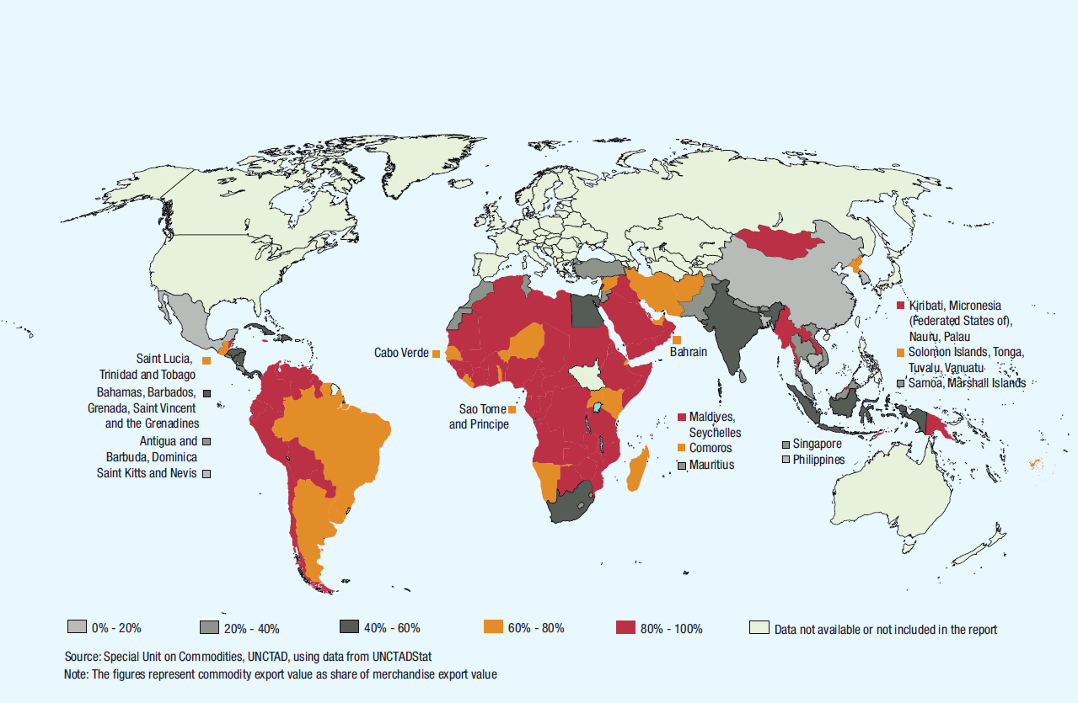
Map of commodity-dependent developing countries

Slide 17
Correlation between prices & per capita income
UNCTAD Commodity Price Index and GDP per capita in developing countries (annual % changes)

Slide 18
Transmission channels

Slide 19
Terms of trade & price volatility
Fiscal and monetary policy
Impacts at the micro level

Slide 20
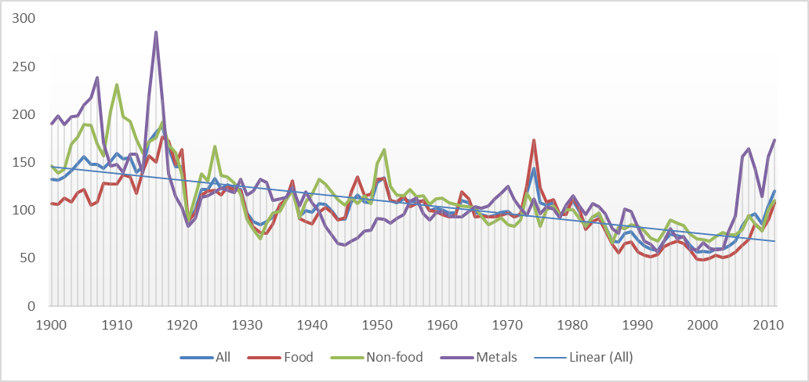
Negative terms of trade

Slide 21
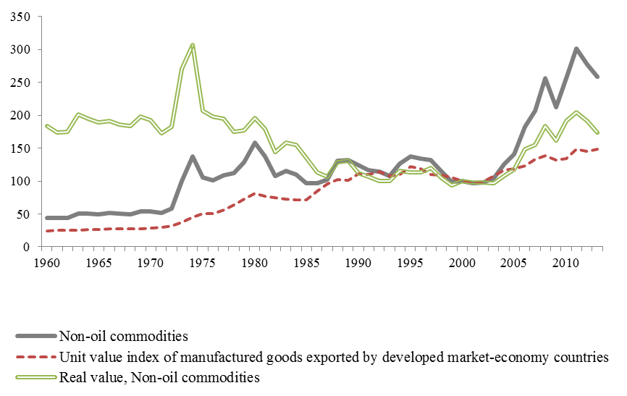
CD and development: terms of trade

Slide 22
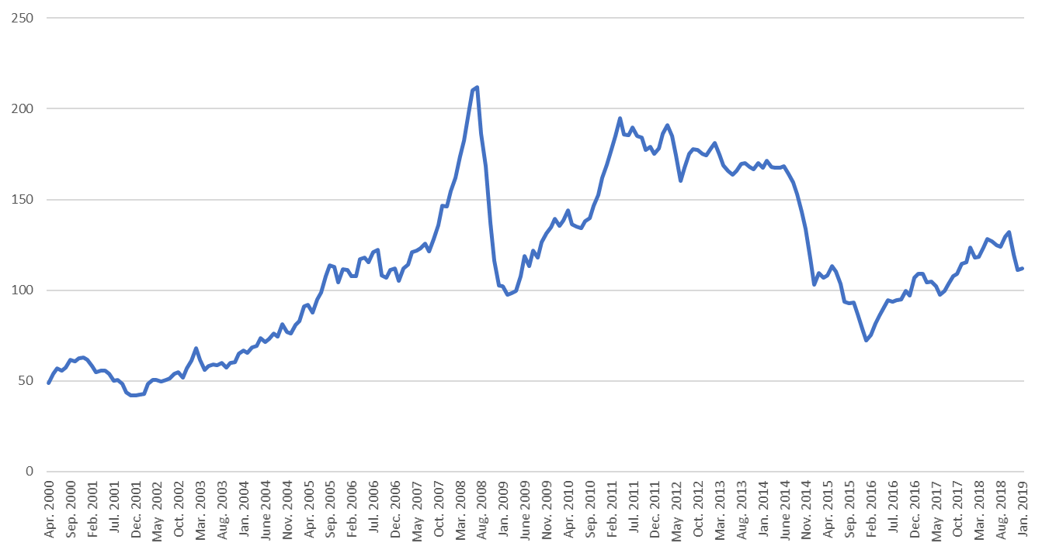
Commodity boom and bust
Recent developments in global commodity markets

Slide 23
Commodity boom and bust: group correlations
Recent developments in global commodity markets
UNCTAD Commodity Price Indices (2015=100)

Slide 24
Commodity price volatility & negative trend
Recent developments in global commodity markets
UNCTAD Commodity Price Indices (2015=100)

Slide 25
Commodity price volatility
Monthly price, January 2018 vs December 2018 (% change)
Recent developments in global commodity markets

Slide 26
Commodity price volatility
Recent developments in global commodity markets
Monthly price: 2017 vs. 2018 (% change)

Slide 27
Commodity price volatility
Recent developments in global commodity markets
Coefficient of variation of UNCTAD commodity price indices (Jan 2000 - Feb 2019)

Slide 28
Commodity price volatility
Recent developments in global commodity markets
Monthly percentage changes of UNCTAD Commodity Price Index (all groups)

Slide 29
Commodity price volatility
Recent developments in global commodity markets
59% of the monthly changes from February 2000 to February 2019 were positive; 41% were negative
56% of the shocks with an absolute value above 5% were positive; 44% were negative
The average size of negative shocks was -4.3%; the average size of positive shocks was 3.9%
Large positive shocks followed by large negative shocks create high uncertainty

Slide 30


Burden of volatility mostly borne by producers
Recent developments in global commodity markets
Market concentration along the Global Coffee Value Chain
30 RETAILERS
25 million coffee producers & workers
2 MAJOR
ROASTERS
[¼ market]
BIG 5 TRADERS [40% market]
500 million coffee consumers daily
Source: UNCTAD secretariat

Slide 31
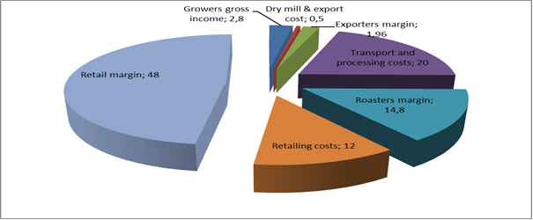
Unfair distribution of value
Recent developments in global commodity markets

Slide 32
Why is price volatility a problem?
Price volatility creates uncertainty for governments, commodity producers, traders and exporters
Threat to the sustainability and continuity of public development programmes
Risk for the achievement of SDGs in commodity-dependent developing countries

Slide 33
Fiscal and monetary policy

Slide 34
CD and development: Dutch Disease
Several negative factors associated with DD:
  Appreciation of currencies due to large inflows of foreign currency; traditional exports are less competitive
  This hampers diversification; leads to de-industrialization
  Also, exchange rate fluctuations
  Macroeconomic volatility
  Contagion leads to economic slowdown in CDDCs.

Slide 35
Negative correlation between prices & debt service

Slide 36
Political instability
Close relationship between natural resource dependence, poor governance and conflict
Probability of civil war peaks at 0.33 when primary commodities represent 25 per cent of GDP
Reason: fights for the control of commodity rents

Slide 37
Effects at the microeconomic level

Slide 38
Indirect effects on HH & firms through channels discussed above (inflation, devaluations, budget deficits, etc.)
Direct effects:
  Declining household income due to drop in producer prices for ex.
  Negative effect of increase in food (for net-food buyers) and fuel prices
Commodity dependence fundamentally developmental challenge

Slide 39
Commodity dependence and food security

Slide 40
Developing countries too dependent on food imports:
  Account for 40% of global food imports, with increasing trend
  Cereals & oilseeds imports: in 2016, at $120 billion, cost was 6 times 1995 value
  Their imports of cereals & oilseeds are 70% of global imports
Grains trade is of utmost importance to CDDCs

Slide 41
Share of developing countries in global food imports (%)

Slide 42
Share of developing countries in global cereals and oilseeds imports (%)

Slide 43
Import bill of developing countries: cereals & oilseeds

Slide 44
Specificity of grains trade
Imports are fragmented with exception of oilseeds
  Most imports are from very large number of countries
  China and Japan are relatively important importers
  Oilseeds are exception: China alone absorbs 40% of total imports
Exports are highly concentrated in a few developed coutries
  Five countries account for almost half of world cereals exports
  One country, the USA, accounts for almost a fifth of total exports
  For oilseeds, USA and Brazil supply more than half of total exports

Slide 45
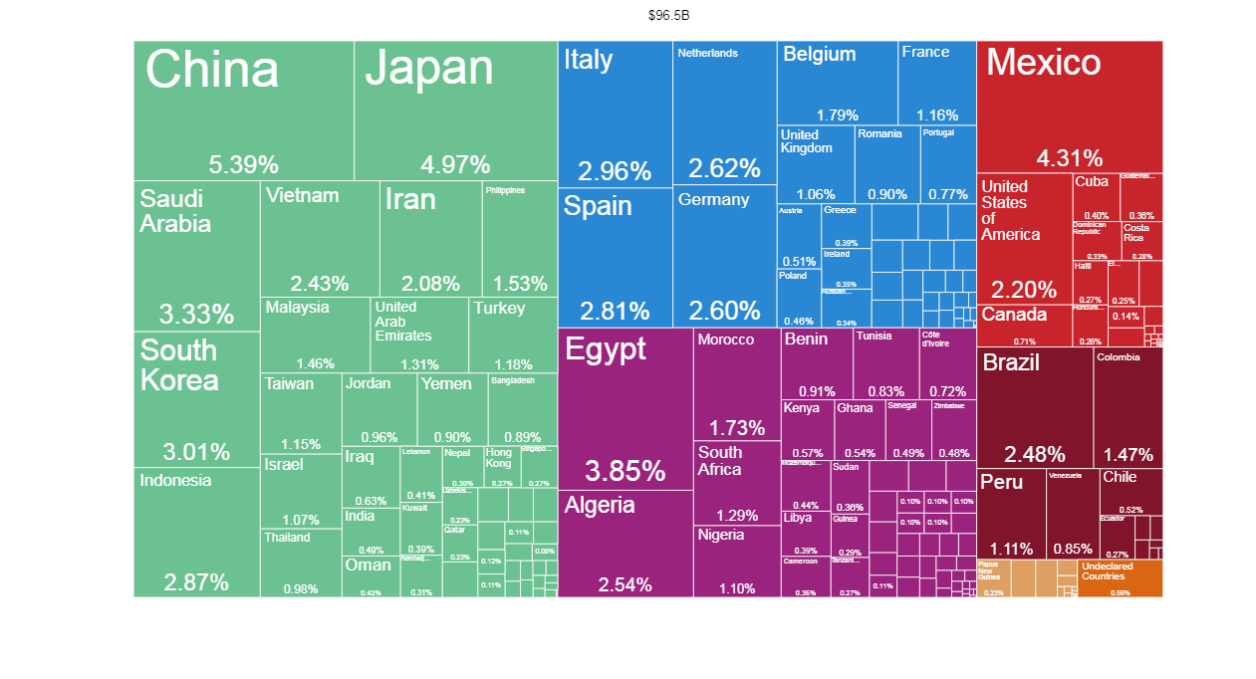
Who imports cereals? Imports in 2016 (10 HS2)

Slide 46
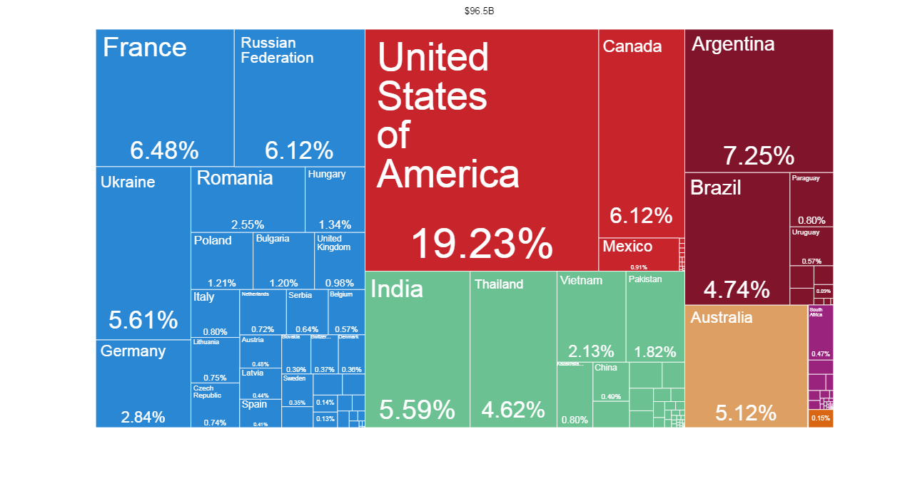
Who are the exporters? Cereal exports in 2016 (10 HS2)

Slide 47
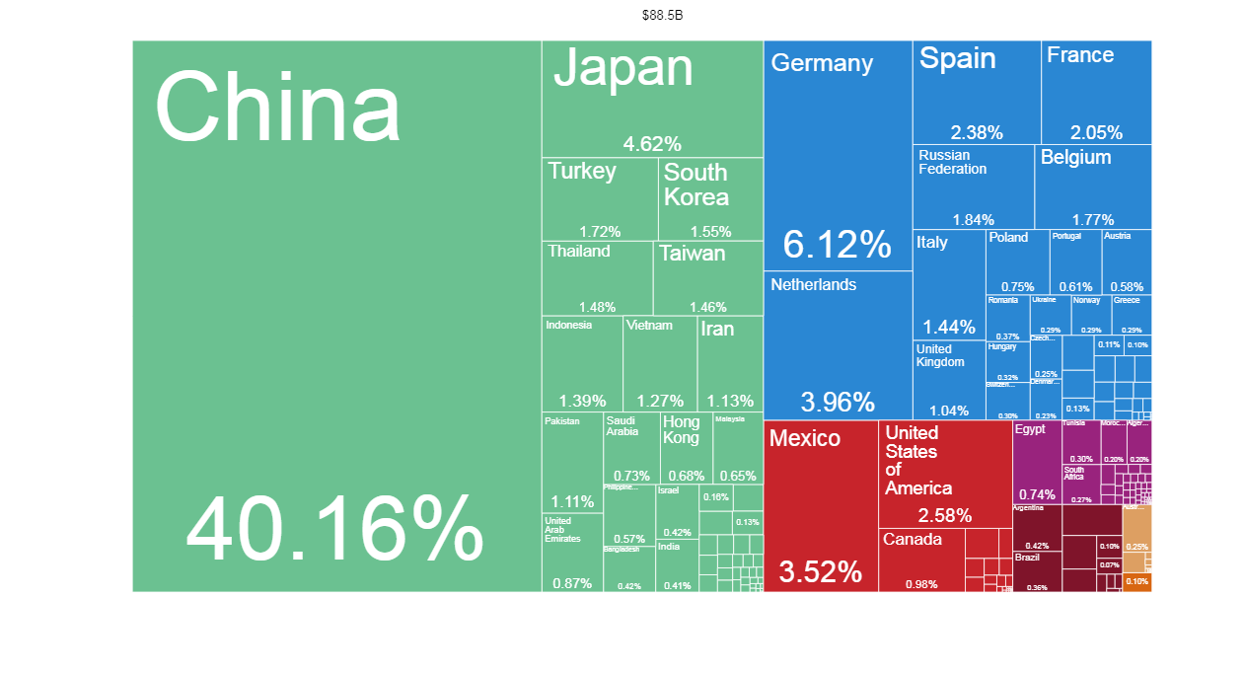
Oilseeds imports in 2016 (12 HS2)

Slide 48
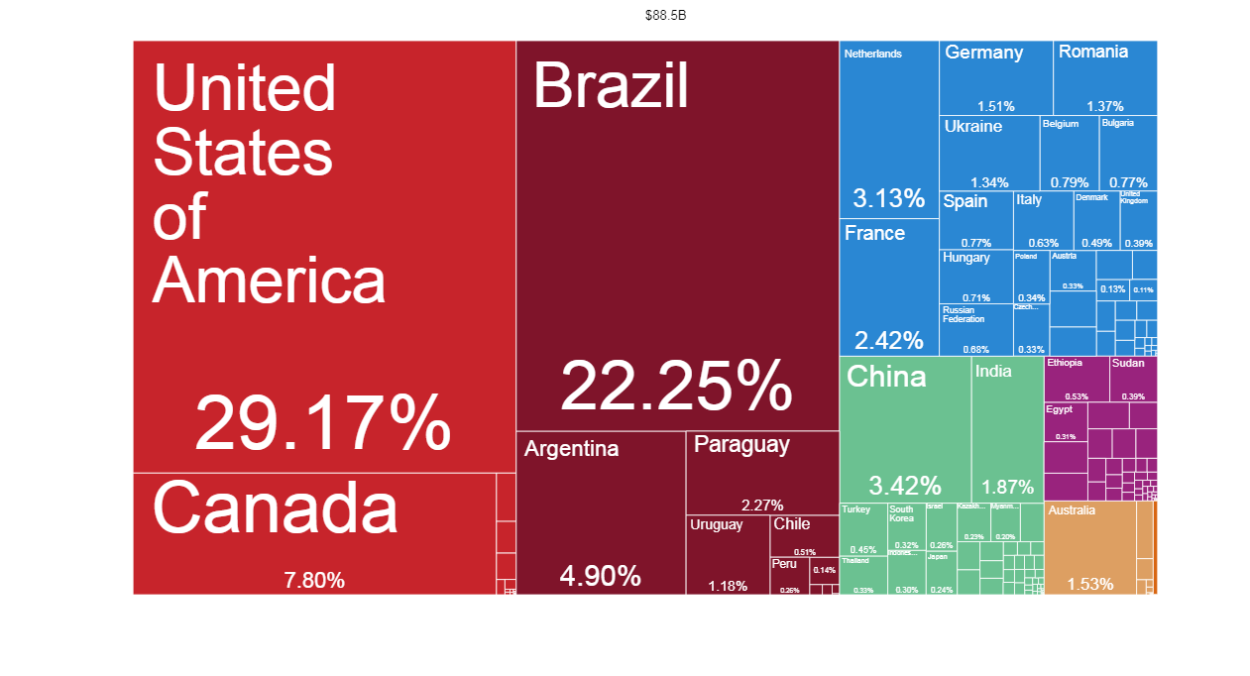
Oilseeds exports in 2016 (12 HS2)

Slide 49
Export and import concentration expose countries to vagaries of international commodity markets
Food security can be compromised if large exporters limit food exports
Stable trade policy is of utmost importance for food security

Slide 50
Managing commodity price risk

Slide 51
Three major instruments
Recent developments in global commodity markets
Revenue stabilization schemes
Financial market instruments
Economic diversification

Slide 52
International commodity agreements
Recent developments in global commodity markets
ICAs for sugar, coffee, cocoa and natural rubber
Objective: Stabilize prices by quotas & buffer stock
Dismantled or ceased to intervene in market in 1980s & 1990s
Also agricultural marketing boards abolished or scaled back

Slide 53
Commodity SWFs and precautionary saving
Recent developments in global commodity markets
Accumulate savings during periods of high prices to enhance resilience during times of low prices
Stabilization
  shield budget from shocks and volatility of commodity revenue
  support countercyclical fiscal policy rules
Saving
  risk management through diversification of assets
  accumulation of assets improves net debt position, reducing financing costs

Slide 54
Financial instruments to hedge commodity price risk
Recent developments in global commodity markets
Futures - standardized, exchange-traded contracts to buy or sell a commodity at a specified future date
Forward contracts - non-standardized, generally OTC-traded agreement of a future sale of a commodity
Options - Right but not an obligation to buy or sell a commodity at a pre-specified price
Swaps - exchange of cash flows based on the price of a commodity

Slide 55
Financial instruments to hedge commodity price risk
Recent developments in global commodity markets
Use financial instruments to hedge commodity price risk not widespread in CDDCs
A few examples for commodity exporters
  Mexico oil hedge
  Petrobras oil hedge
  Codelco copper hedge
Commodity importers use financial instruments to hedge price risk
  Ghana, Jamaica, Morocco, Uruguay oil hedge
  Malawi maize hedge

Slide 56
Example: Mexican oil hedge programme
Recent developments in global commodity markets
Mexico used derivatives (options) to hedge price of oil exports since 2000; seen as world's largest sovereign derivates trade
Options exercised 3 times: 2009 (payout: $5 billion), 2015 ($6.4 billion) and 2016 ($2.7 billion)
For 2019, Mexico placed $1.23 billion in put options to lock in an export price of $55 per barrel
Benefits: less volatility in oil revenue and lower sovereign risk

Slide 57
Commodity exchanges in developing countries
Recent developments in global commodity markets
Regulated market places where commodities and derivatives are traded
Enhance market access and provide physical infrastructure
Price discovery, risk management and facilitation of trade

Slide 58
Commodity-linked bonds
Recent developments in global commodity markets
Link debt obligations to repayment ability
Coupon rates, principal repayments or payment schedules could be linked to commodity prices
Debt payments vary with the price level of export commodities
Examples: Mexican Petrobonds, Sonatrach oil-linked loan
Challenges: no existing liquid market, high risk, political concerns

Slide 59
Weather and climate risks
Recent developments in global commodity markets
Weather is an important source of risk especially affecting small farmers
Such risks often uninsured, leading to inefficient coping strategies:
  Sell productive assets such as livestock or land
  Reduce spending on education or health
  Decrease food consumption

Slide 60
Index-based weather insurance
Recent developments in global commodity markets
Based on weather-related indices such as rainfall or temperature
Trigger a payout if a threshold level of the index is surpassed
Lower transaction costs than indemnity-based insurance
Implemented in countries e.g. Bangladesh, Burkina Faso, Ethiopia, India, Kenya, Malawi, Mexico, Nicaragua, Rwanda, Senegal, Thailand,
Low take up often a challenge

Slide 61
Index-based weather insurance: Examples
Recent developments in global commodity markets
Index-based weather insurance piloted in India in 2003
  adopted by government in 2007
  12 million farmers, 40 different crops over 15 million hectares covered
Kilimo Salama project started in 2009 with a pilot insuring 200 farmers in Kenya against drought and excess rain
  expanded to Rwanda in 2012 and to Tanzania in 2013
  covered 187,000 farmers in three countries by the end of 2013
  project transformed to commerical provider in 2014

Slide 62
Diversification

Slide 63
Two forms of diversification
Recent developments in global commodity markets
First understand commodity price risk
  Market or global risk
  Idiosyncratic risk
Value addition and vertical diversification
Horizontal diversification

Slide 64
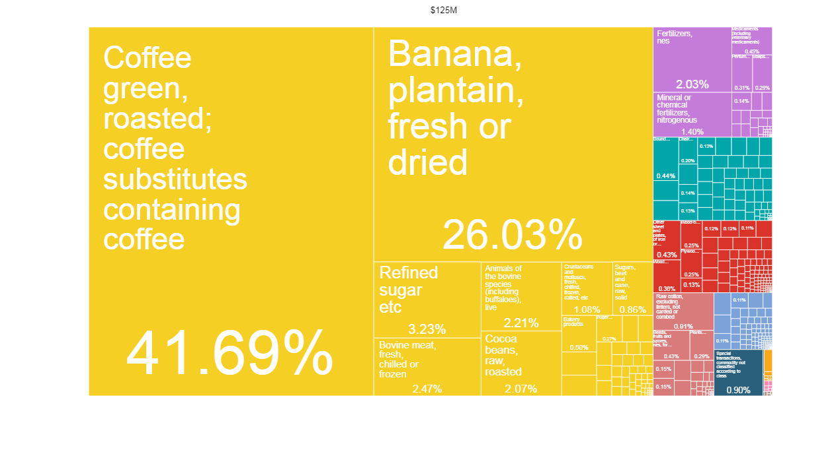
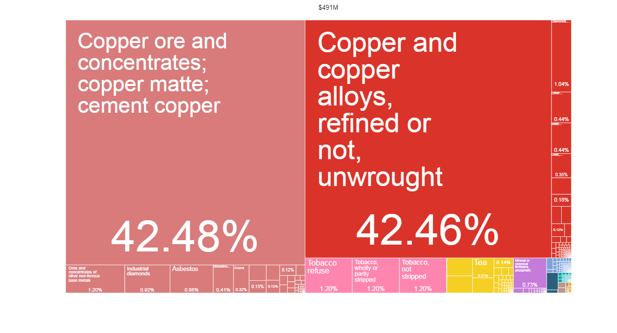
Costa Rica's and Zambia's exports in 1965…

Slide 65
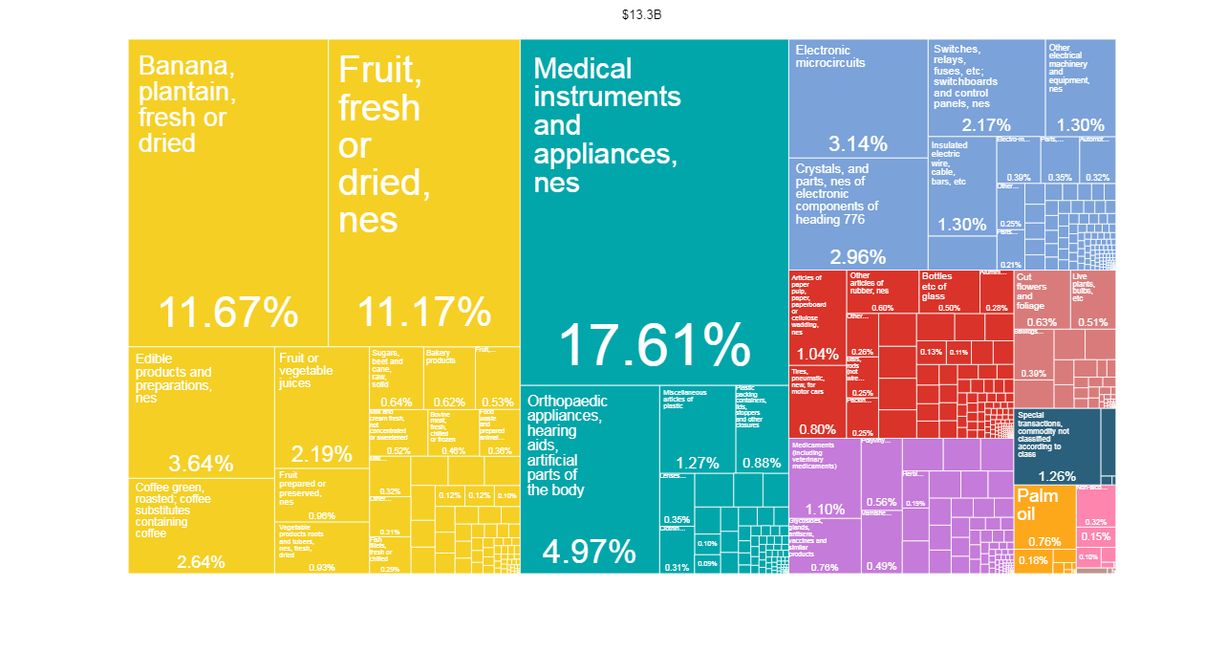
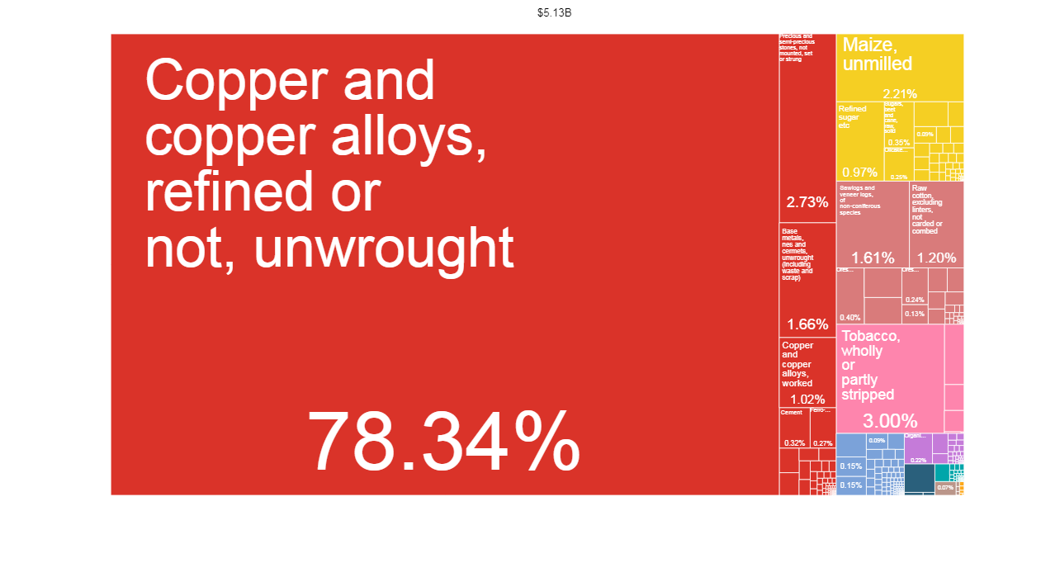
Costa Rica's and Zambia's exports in 2016

Slide 66
Costa Rica: targeted policies stimulated horizontal & vertical diversification within & outside commodity sector
Botswana and Sierra Leone: strong institution and stable policy framework made diamond industry a driver of growth in Botswana; Sierra Leone is counter-example
Indonesia: nickel export ban was a risky strategy to pursue industrial policy objective aimed at fostering domestic value addition; did not reach expected results
Nigeria: local content requirement in oil and gas industry could have had more success if it had been integrated in broader development strategy
Zambia: no diversification despite high economic growth during copper boom; growth and rise in poverty occurred simultaneously

Slide 67
Lessons and the way forward

Slide 68
Commodity producing countries
Mitigate impact of high price volatility on incomes through:
  Safety nets
  Risk management tools;
Diversify Economy: horizontally & vertically to reduce volatility effect;
Improve transparency & accountability;
Increase access to finance for commodity development;
As value chain involves so many stakeholders:
  ‘Coordination' needed to safeguard each party's interests
  Self-regulation has failed
  Push for global instrument to ensure transparency & equity

Slide 69
Build resilient economies
  “Lock” multiyear countercyclical fiscal policy
  Overhaul governance system, especially management of windfall revenues
Expand linkages with economy & society at large
  Adding value, where economically relevant, contributes to diversification
  Social protection; investing in human capital
Build capacity in contract negotiation
  Train locals in contract negotiation
  Where capacity is not available, seek help from experts
  Avoid ruinous race to the bottom; adopt instead regional policy standards
Create strong commodity market research institutions

Slide 70
It takes two to tango
Investors’ role in fostering shared value

Slide 71
Ensure stability of supply by sharing fairly value chain benefits
  Adopt inclusive business models that go beyond profit maximization
  Accept introduction of safeguards in investment law & contracts
Reconcile profit with impact investment, a nascent trend
Meet the duty of care and diligence especially when operating in countries with weak institutions
Establish, together with hosts, mechanisms for greater accountability & monitoring
Foster transparency at all levels of the value chain

Slide 72
Thank you.
Contact: janvier.nkurunziza@un.org

