Slide 1
Harnessing FDI for Sustainable Development:
UNCTAD’s IPFSD
Investment Policy Framework for Sustainable Development
Ariel Ivanier
Policy Research Section
Investment Policies Branch
Division on Investment and Enterprise
UNCTAD

Slide 2
UNCTAD’s IPFSD: Why Now? Context
Evolving global investment landscape for a new investment-development paradigm/path
Imperative for mainstreaming sustainable development into the investment policy core
Investment policy making at a crossroads: at times of reflection, review and revision
Challenges of systemic flaws, issues of policy coherence, synergy and effectiveness
Need guidelines and tools

Slide 3
2011 FDI Inflows:
Up across all major economic groupings
FDI inflows by group of economies, 1990–2011
(Billions of dollars)
51%
Notes:
3

Slide 4
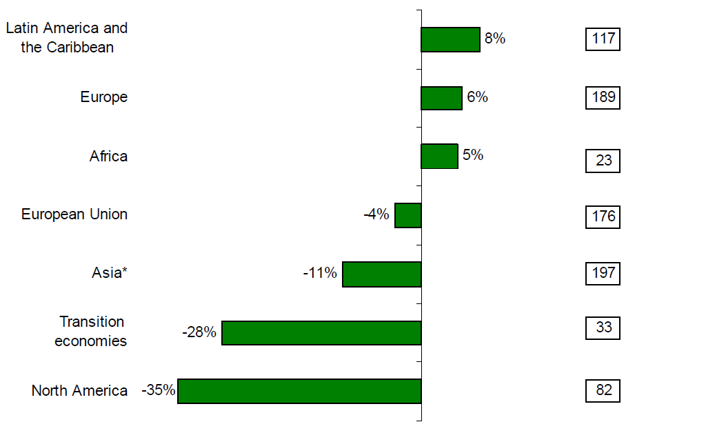
First Six Months of 2012
Latin America tops growth rate and amount of FDI inflows
By group of economies, 2011 (H1) – 2012 (H2)
(Percent and billions of US dollars)

Slide 5
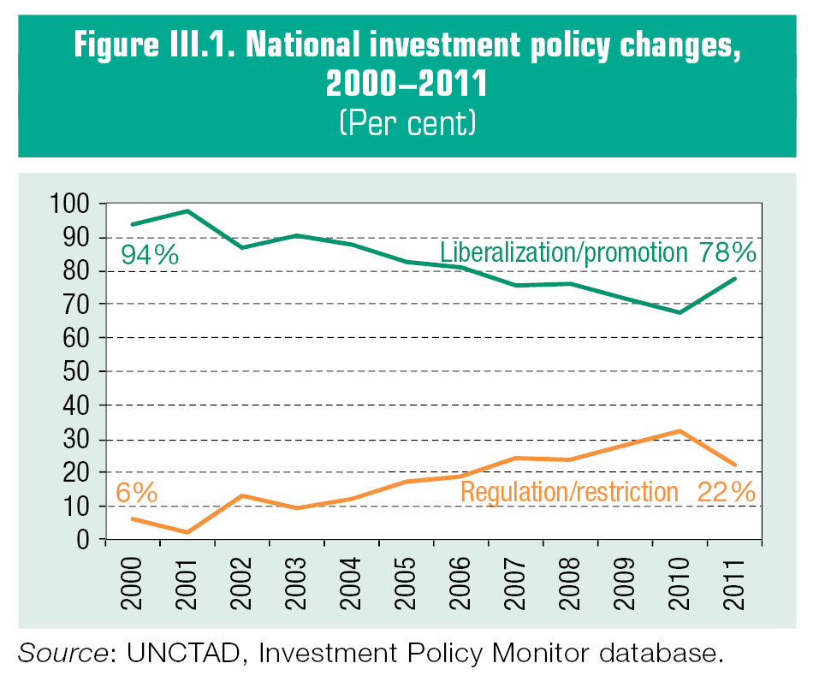
National Investment Policies:
Continuous Dichotomy
National investment policy changes, 2000 – 2011
(Per cent of measures)
Notes:
5

Slide 6
International Investment Policies:
Shifting from the bilateral to the regional level
Trends of BITs and “other IIAs”, 1980 – 2012
(Number of treaties)
Notes:
6

Slide 7
ISDS Mechanism:
Investors continue using it – some States express discontent
Known investor-State treaty-based disputes, 1987-2012

Slide 8
UNCTAD’s IPFSD: Why Now? Context
Evolving global investment landscape for a new investment-development paradigm/path
Imperative for mainstreaming sustainable development into the investment policy core
Investment policy making at a crossroads: at times of reflection, review and revision
Challenges of systemic flaws, issues of policy coherence, synergy and effectiveness
Need guidelines and tools

Slide 9
IPFSD: Key Characteristics
Placing sustainable development at the core
Holistic
IPFSD
Addressing all dimensions of investment policy
Systemic
Fostering interaction with relevant national and international policies
Synergistic

Slide 10
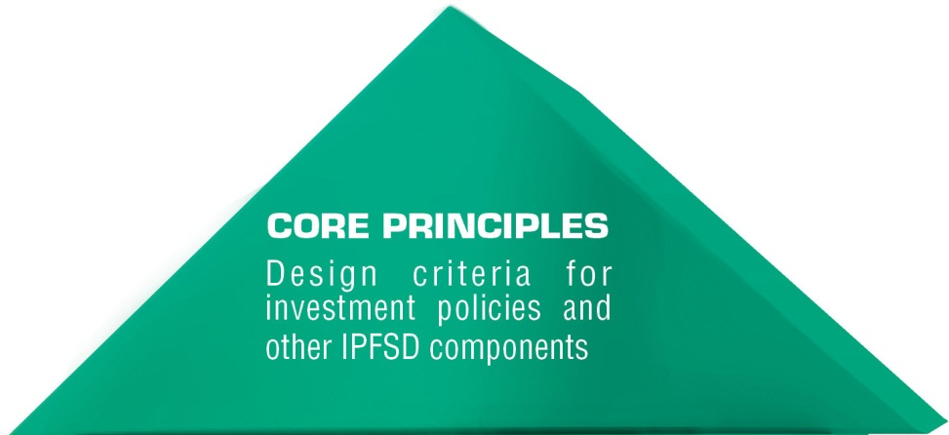

IPFSD: Structure & Components
IPFSD helps policymakers address today’s investment policy challenges

Slide 11
IPFSD: Core Principles for Investment Policymaking
1
Investment for sustainable development
…overarching objective of investment policymaking …
2
Policy coherence
…grounded in a country’s overall development strategy
… coherent and synergetic …
3
Public governance and institutions
…involving all stakeholders … standards of public governance
…predictable, efficient and transparent procedures for investors
4
Dynamic policymaking
…regular reviews for effectiveness and relevance …
5
Balanced rights and obligations
…setting out rights and obligations of States and investors in the interest of development
6
Right to regulate
…in the interest of the public good and to minimize potential negative effects
7
Openness to investment
…in line with development strategy
… open, stable and predictable entry conditions …
8
Investment protection and treatment
…adequate protection to established investors … non-discriminatory
9
Investment promotion and facilitation
…aligned with sustainable development goals
… minimize risk of harmful competition for investment
10
Corporate governance and responsibility
…promote adoption of and compliance with best international practices of CSR …
11
International cooperation
…address shared investment-for-development challenges
… avoid investment protectionism

Slide 12
National Investment Policymaking: the Challenges
Notes:
1 Connect to other areas and ensure development outcomes: e.g. enterprise development, techonology, industrial policy, trade and job creation
2 Look at qualitative aspects: Promote CSR standards and green investments
3. Measuring sustainable development impact of policies and responding to changes in the policy environment

Slide 13
National Investment Policymaking: IPFSD’s Features
1
Section on strategic investment priorities and investment policy coherence for productive capacity building, including sub-sections on investment and: Human resource development, Infrastructure (including section on PPPs), Technology, Enterprise development
Attention to investment policy options for the protection of sensitive industries
Sections on other policy areas geared towards overall sustainable development objectives to ensure coherence with investment policy
Integrating investment policy in development strategy

Slide 14
National Investment Policymaking: IPFSD’s Features
2
Specific guidelines for the design of investment-specific policies and regulations, including not only establishment and operations, treatment and protection of investments, and investment promotion and facilitation, but also investor responsibilities
Guidance on the encouragement of responsible investment and on guaranteeing compliance with international core standards
Guidance on investment promotion and use of incentives in the interest of inclusive and sustainable development
Specific guidelines aimed at minimizing potential negative effects of investment, such as tax avoidance, anti-competitive behaviour, core labour standards, environmental impact
A sub-section on access to land, incorporating the Principles for Responsible Agricultural Investment (PRAI)
Incorporating sustainable development objectives in investment policy

Slide 15
National Investment Policymaking: IPFSD’s Features
3
Ensuring investment policy relevance and effectiveness
Section on investment policy effectiveness, including guidance on public governance and institutional capacity-building
Guidance on the measurement of policy effectiveness, with reference to quantitative investment impact indicators and UNCTAD tools (FDI Attraction and Contribution Indices)

Slide 16
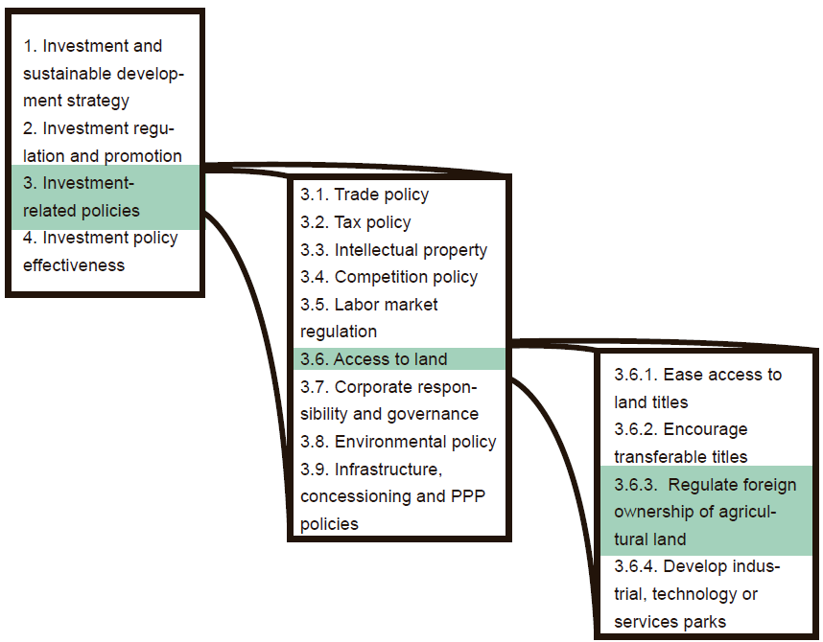
National Investment Policymaking in the IPFSD: How It Works

Slide 17

THANK YOU!
The Investment Policy Hub:
http://investmentpolicyhub.org
UNCTAD websites:
www.unctad.org/diae
www.unctad.org/wir
www.unctad.org/fdistatistics
@unctadwif

