Slide 1

Trade Logistics, Transport and Trade Facilitation
Geneva, April 2013
Short courses for Permanent Missions in Geneva
José María Rubiato Elizalde
Head Trade Logistics Branch
jose.rubiato@unctad.org

Slide 2
Programme for today
Geneva, Palais des Nations | Room XXIII
10:00 - 10:05 | Welcome address by Mohan Panicker DTL
10:05 - 11:15 | International transport: persisting and emerging issues for developing countries: Presented by José María Rubiato Followed by Q&A
11:15 – 12:30 | Trade facilitation: basic concepts, evolving content and most recent developments: challenges and opportunities for developing countries Presented by José María Rubiato Followed by Q&A

Slide 3
10:05 - 11:15
International transport: persisting and emerging issues for developing countries:

Slide 4
We will discuss
How global trade has evolved recently
What role transport and logistics play
Some challenges Developing Countries face in trade logistics

Slide 5
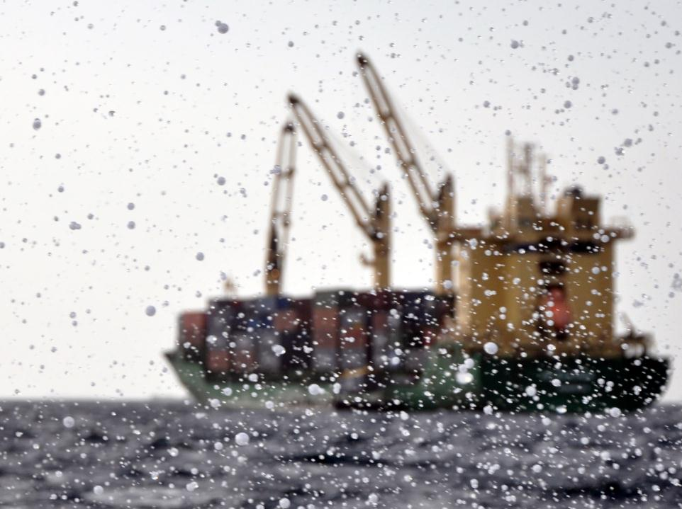
Trade, Transport and International Logistics: An Introduction

Slide 6
Trade, Transport, Logistics and Technologies: An Introduction
Globalization
Role of transport
Role of logistics
Role of technologies

Slide 7
Trade, Transport, Logistics and Technologies: An Introduction
Globalization
Role of transport
Role of logistics
Role of technologies

Slide 8
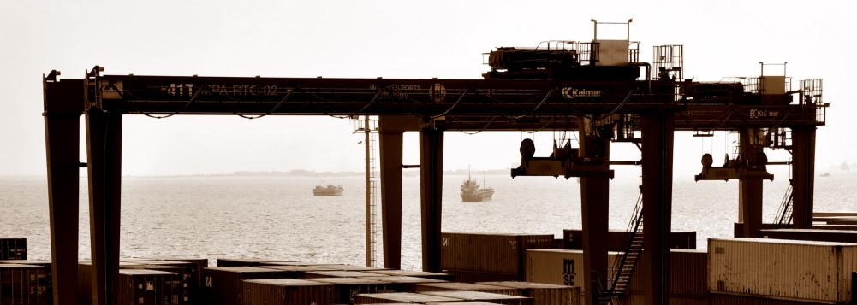
Globalization of trade
What is meant by “Globalization” of trade?
Global production, with increased trade in components and unfinished products

Slide 9
Trade in intermediate goods
Source: UNCTAD TD/B/C.I/16, 2011

Slide 10
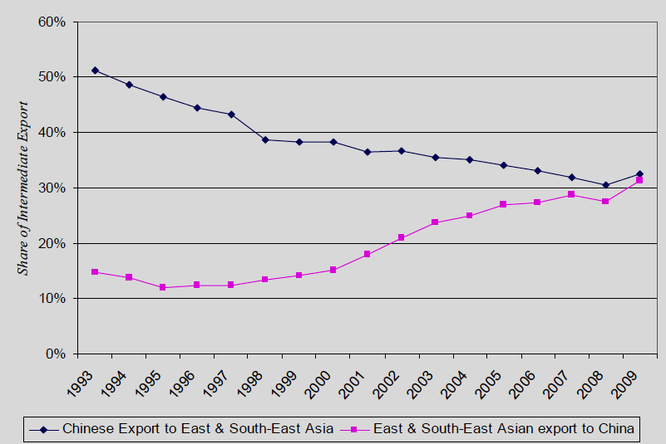
Trade in intermediate goods
Source: UNCTAD TD/B/C.I/16, 2011

Slide 11
Globalization of trade
(past…) international economy:
Trade in raw materials and finished products
(Trend towards...) globalized Economy:
More trade in intermediate products
More trade within companies
More JIT (Just in Time Deliveries)
Logistics part of production process

Slide 12
Globalization of trade
The ways and means of Globalization?
Trade liberalization
Telematics
Standardization
Transport and Logistics

Slide 13
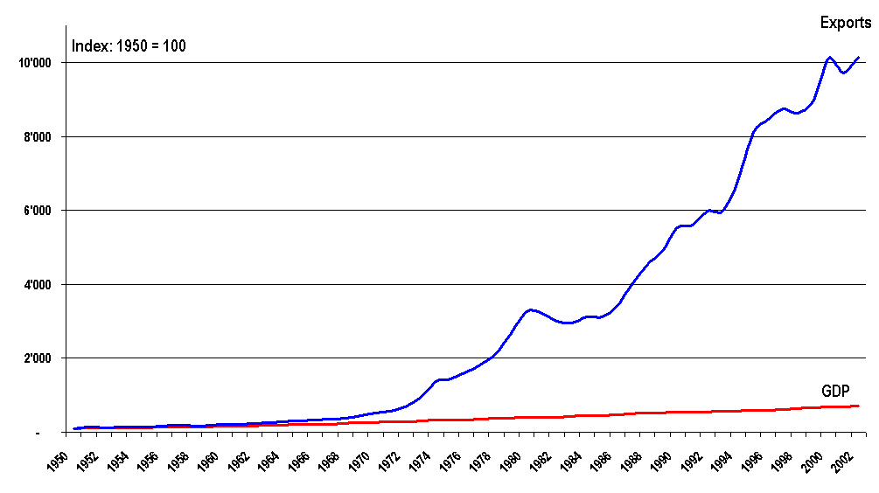
Trade grows faster than GDP
Source: JH based on data from UNCTAD and from WTO

Slide 14
Elasticity Trade/GDP
Exports = 2.5 GDP
Source: UNCTAD

Slide 15
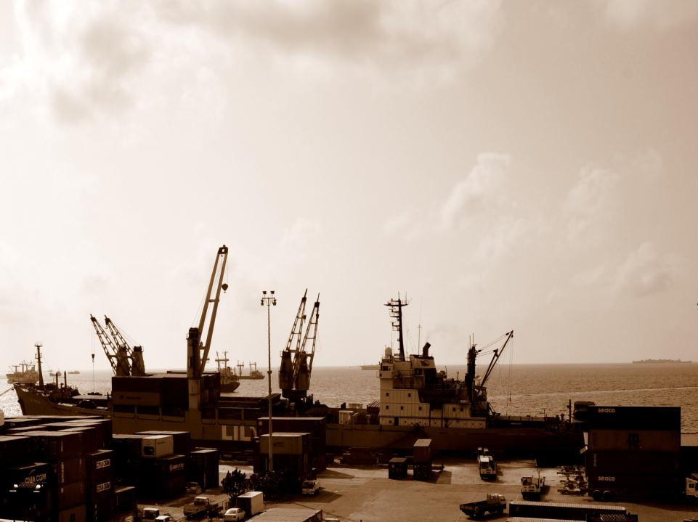
For a country’s GDP to grow, e.g., 5% trade “needs” to grow 7 – 12%
Notes:
Photo by JH in Dar es Salaam

Slide 16

On the Geography of Trade

Slide 17
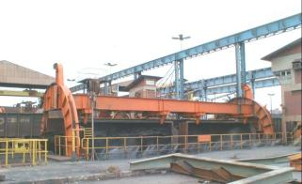
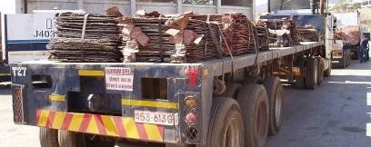
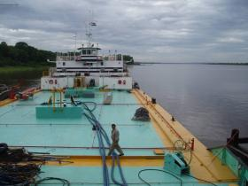
Traditional “Geography of Trade”
Transportation of all kinds of commodities for industrial processing (South -> North)

Slide 18
Traditional “Geography of Trade”
Transportation of all kinds of commodities for industrial processing (South -> North)
Exchange of industrial products for consumption
(North <-> North; and North -> South)

Slide 19
Traditional “Geography of Trade”
Transportation of all kinds of commodities for industrial processing (South -> North)
Exchange of industrial products for consumption
(North <-> North; and North -> South)
Supplies of parts and components for industrial production
(North <-> North)

Slide 20
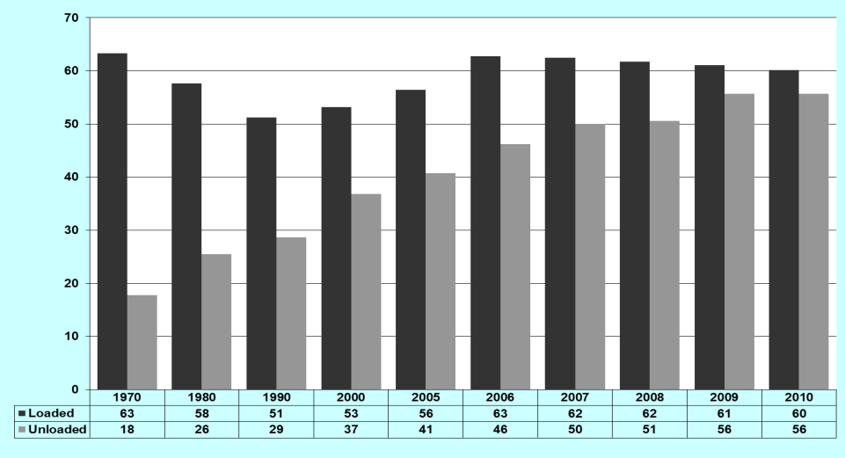
% participation of developing countries in seaborne trade (tons)
Source: UNCTAD, Review of Maritime Transport, 2011

Slide 21
% participation of developing countries in seaborne trade (tons)
Old Scenario:
Developing countries exported large volumes of raw materials and imported high value (low volume) manufactured goods
Source: UNCTAD, Review of Maritime Transport, 2011

Slide 22
% participation of developing countries in seaborne trade (tons)
Today’s Scenario:
Developing countries participate in globalized production.
They also import raw materials and also export manufactured goods
Source: UNCTAD, Review of Maritime Transport, 2011

Slide 23
Before and after “the crisis”
Major industrialized countries
  Twenty years up to 2009: +2.2%
  Next twenty years forecast: +1.8%
Major developing countries
  Twenty years up to 2009: +6.3%
  Next twenty years forecast: +5.9%
Average
  Twenty years up to 2009: +2.9%
  Next twenty years forecast: +3.5%
Source: IHS-Fairplay, as presented to IAME 2010, Lisbon, July 2010

Slide 24
Trade, Transport, Logistics and Technologies: An Introduction
Globalization
Role of transport
Role of logistics
Role of technologies

Slide 25
Mode of transport of global trade metric tons (excluding intra-EU)
Source: Global Insight

Slide 26
Mode of transport of global trade
USD (excluding intra-EU)
Source: Global Insight

Slide 27
Modal split: national transport
China, EU, Japan,
Russia, USA ?
Tonne-miles. Slide by Michel Savy, IML, 2008

Slide 28
Modal split: national transport
Slide by Michel Savy, IML, 2008

Slide 29
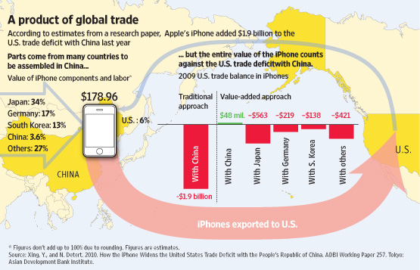
Globalization and international transport

Slide 30





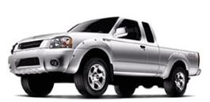
Globalization and international transport
Optimised production
MORE “transport” added value incorporated than 20 years ago. Why?

Slide 31
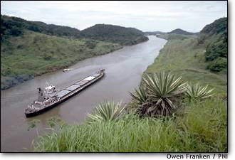
Globalization and international transport
Less expensive
BUT: we pay MORE for “transport” than 20 years ago. Why?
Trade
Transport
GDP

Slide 32
Trade, Transport and International Logistics: An Introduction
Globalization
Role of transport
Role of logistics
Role of technologies

Slide 33
Logistics in the supply chain
Supply Chain
Logistics
Transport
Source: “logistics management”, IML, Lausanne

Slide 34
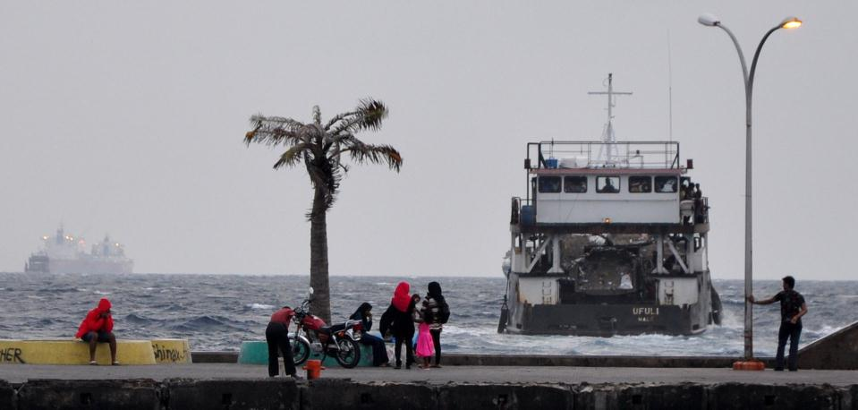
Logistics: consists of…
Transport
Inventory holding
Administration

Slide 35
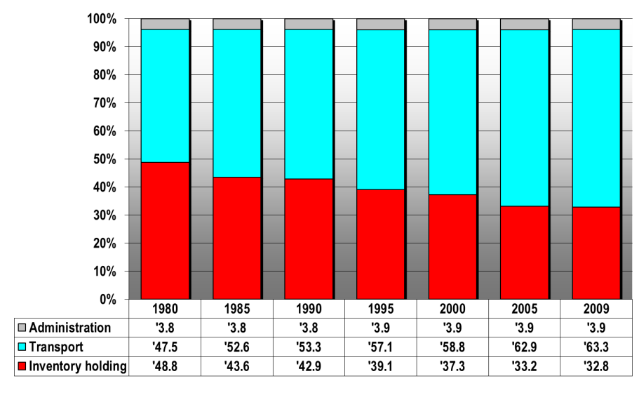
Logistics expenditure in USA, %
Source: CSCM – State of Logistics Report 2010
Source: “”State of Logistics Report”, USA

Slide 36
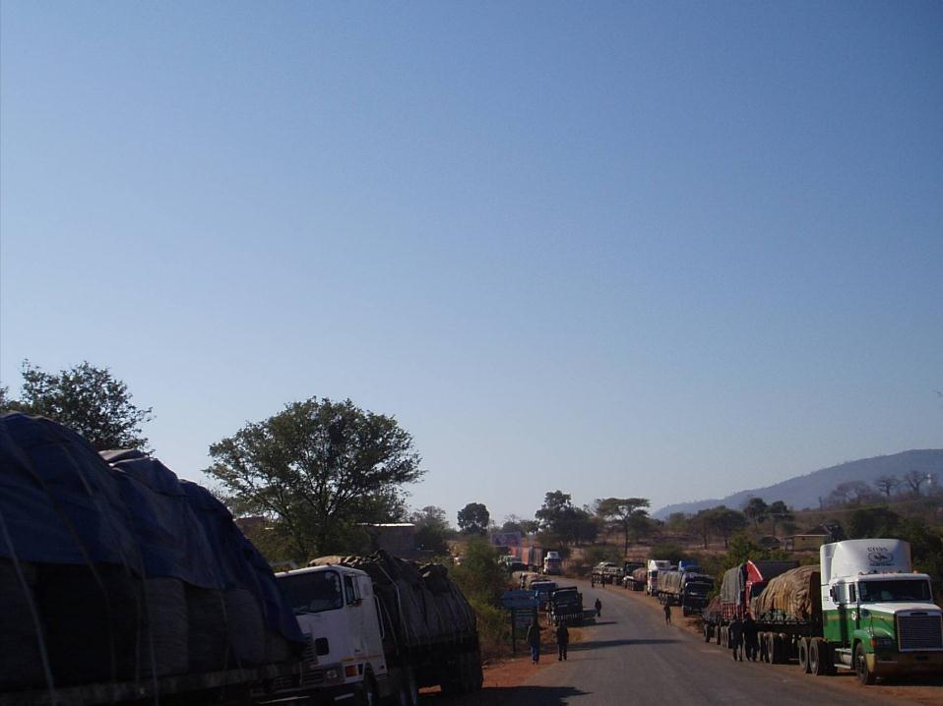

Waiting trucks at a border

Slide 37
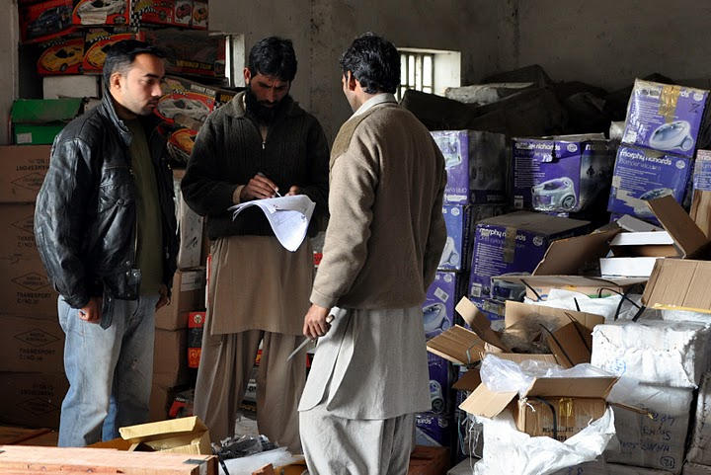
Notes:
37

Slide 38
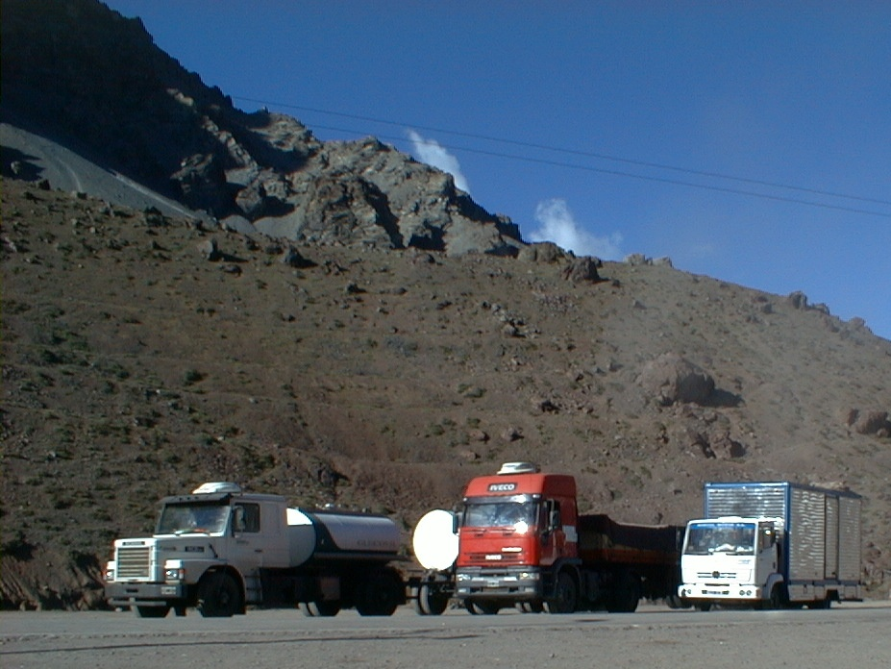

Slide 39
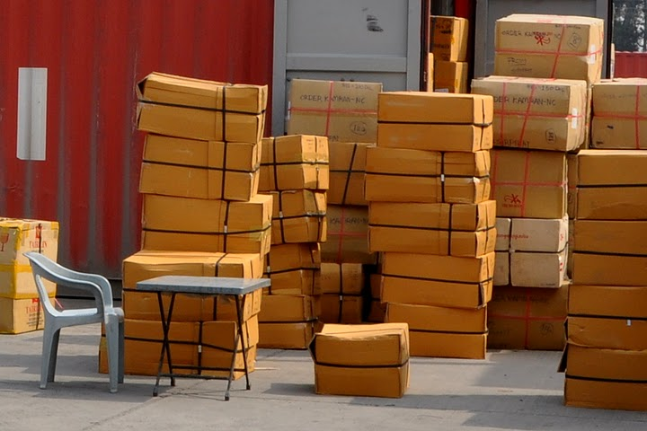
Notes:
39

Slide 40

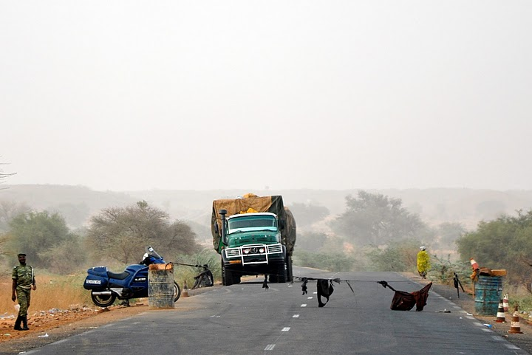

Slide 41
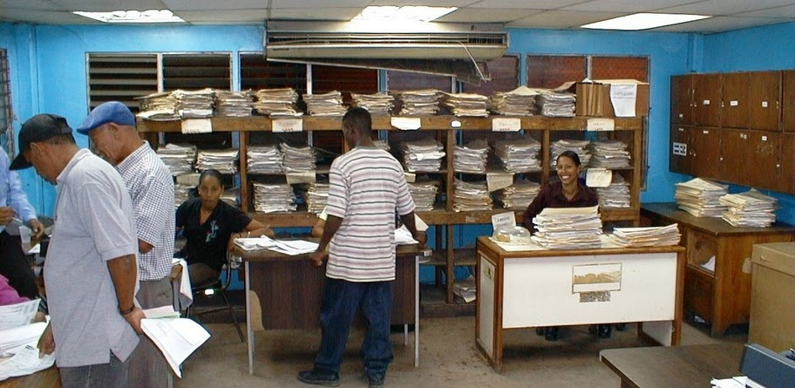

Slide 42
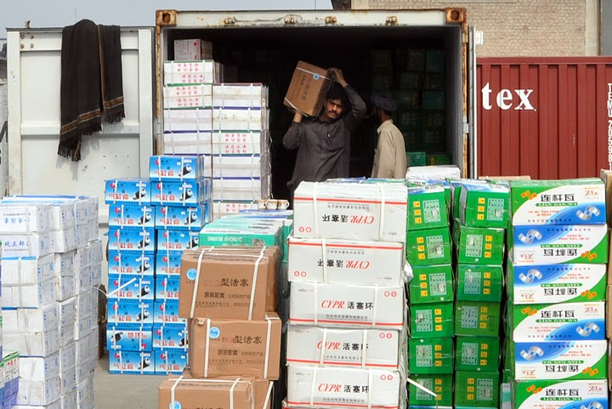

Slide 43
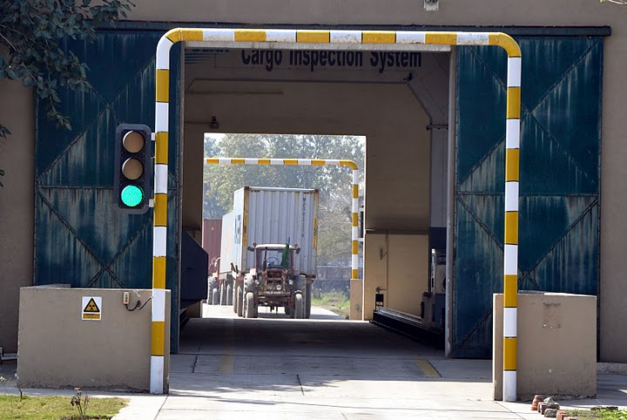

Slide 44
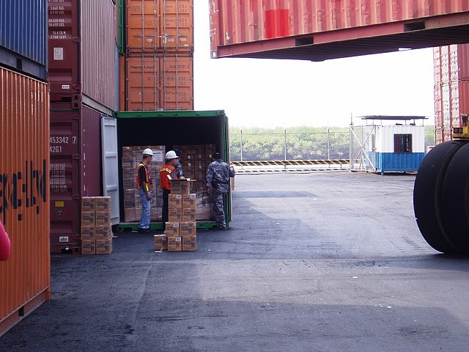

Slide 45
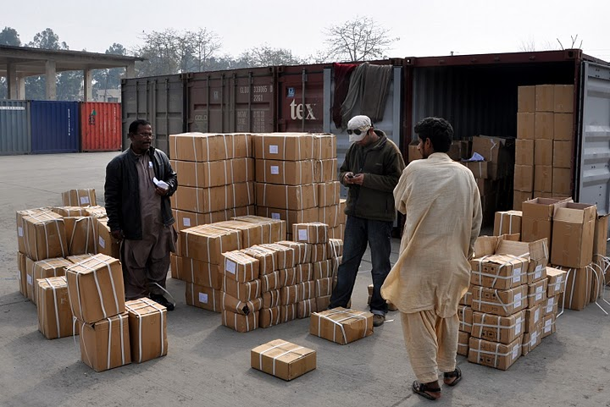

Slide 46
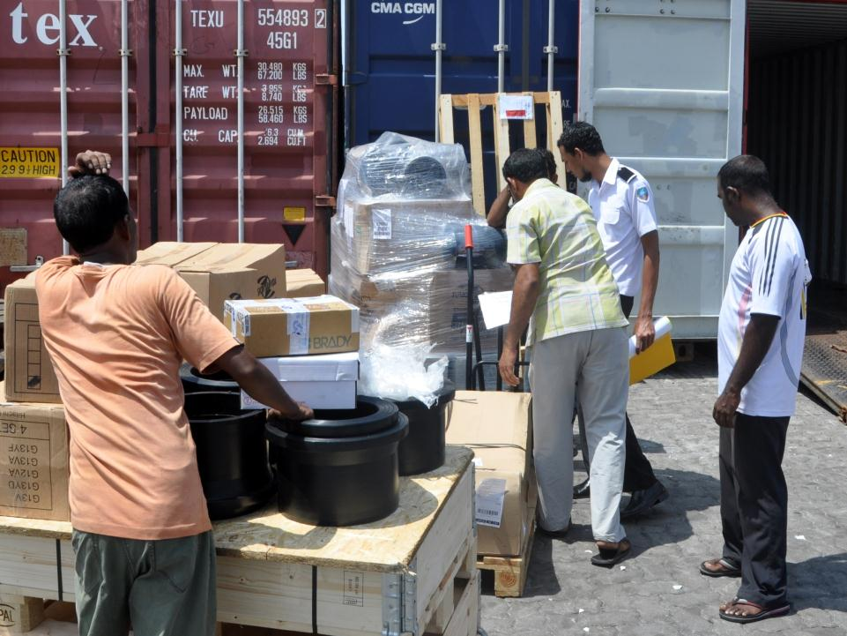

Slide 47
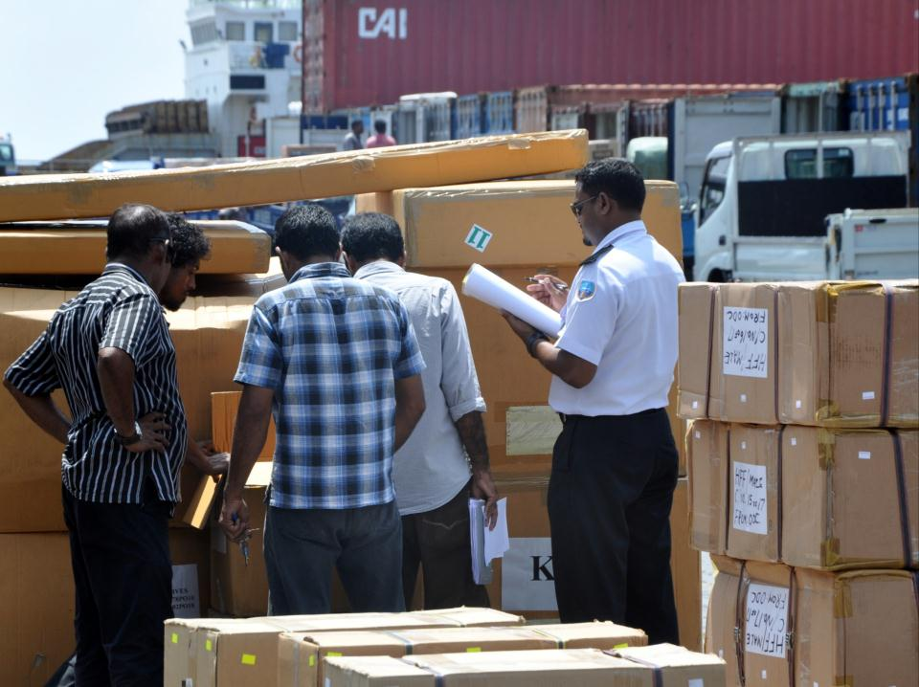

Slide 48
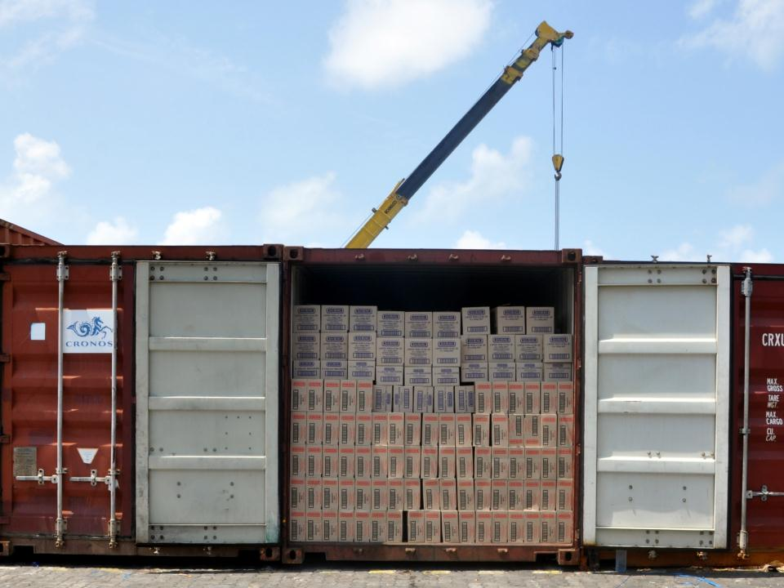

Slide 49
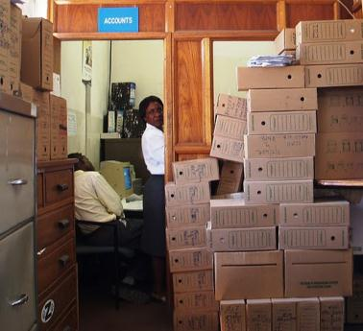
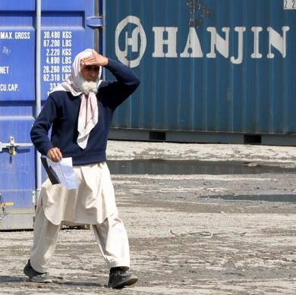
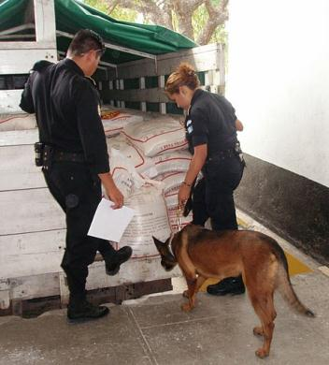

Slide 50

Globalization and
International Logistics
Within global logistics expenditure,
  Warehousing and financing exp. decreases
  Transport expenditure increases, because
    More frequent deliveries, “Just in Time” (JIT)
    Better quality services; secure, safe, reliable

Slide 51
Trade, Transport, Logistics and Technologies: An Introduction
Globalization
Role of transport
Role of logistics
Role of technologies

Slide 52
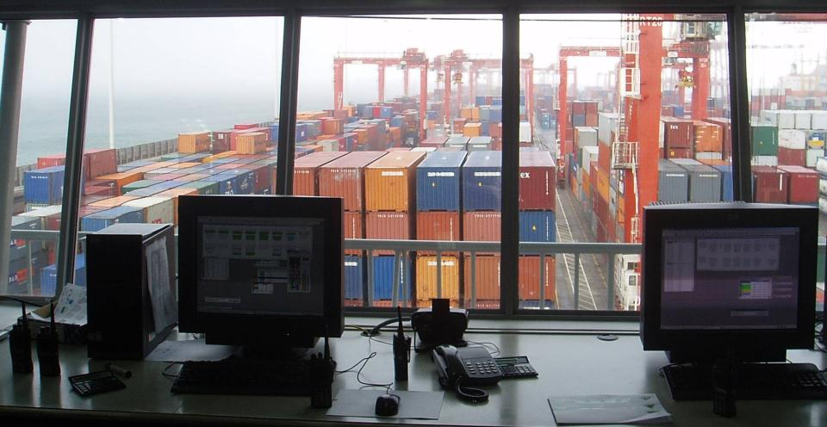
Examples of technologies ?

Slide 53
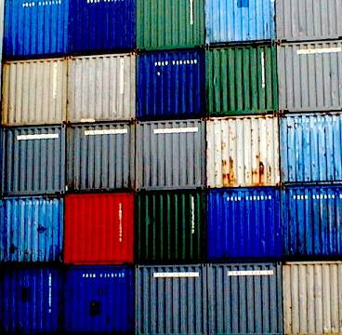
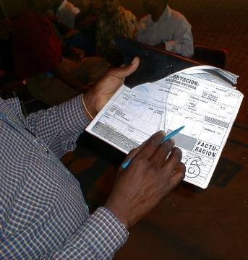
Technologies in international logistics
30 years ago:
Containerization
Today:
Telematics

Slide 54
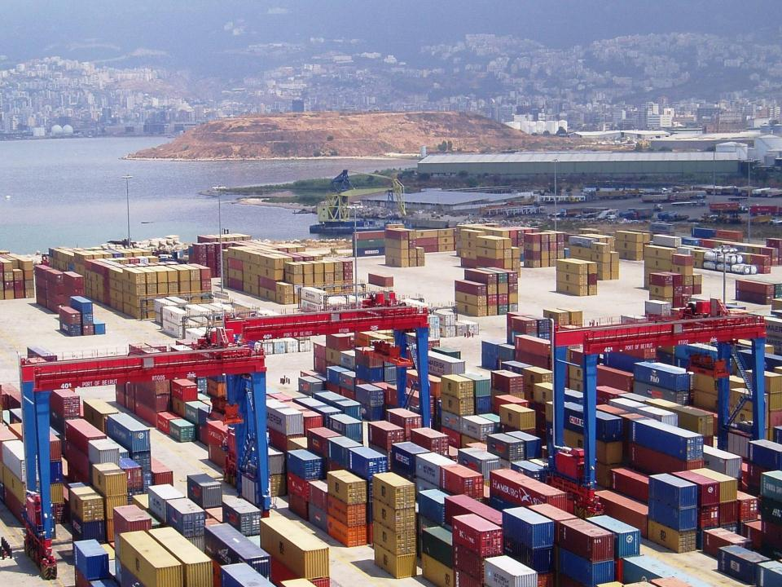
…Beirut

Slide 55
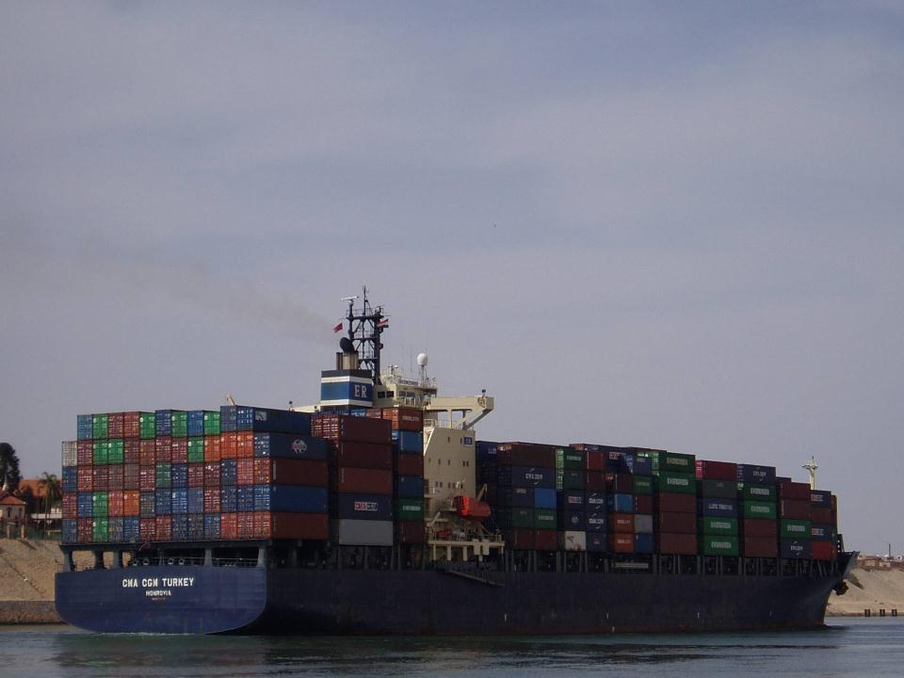
…Suez Canal

Slide 56
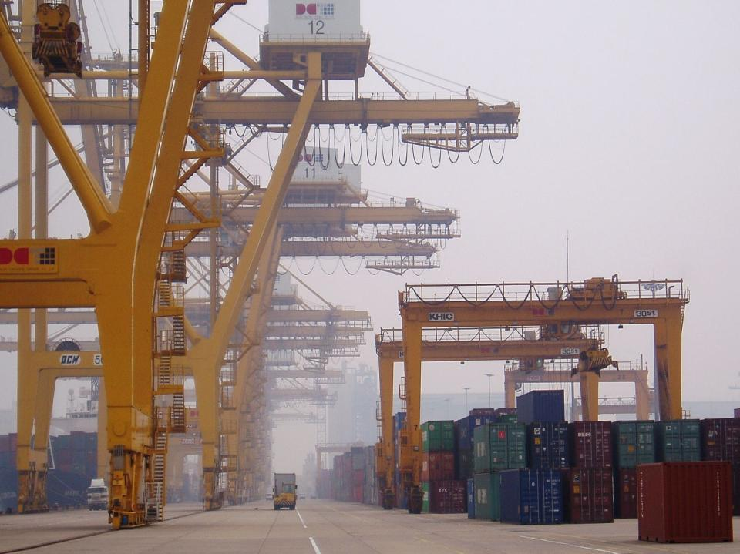
… China

Slide 57
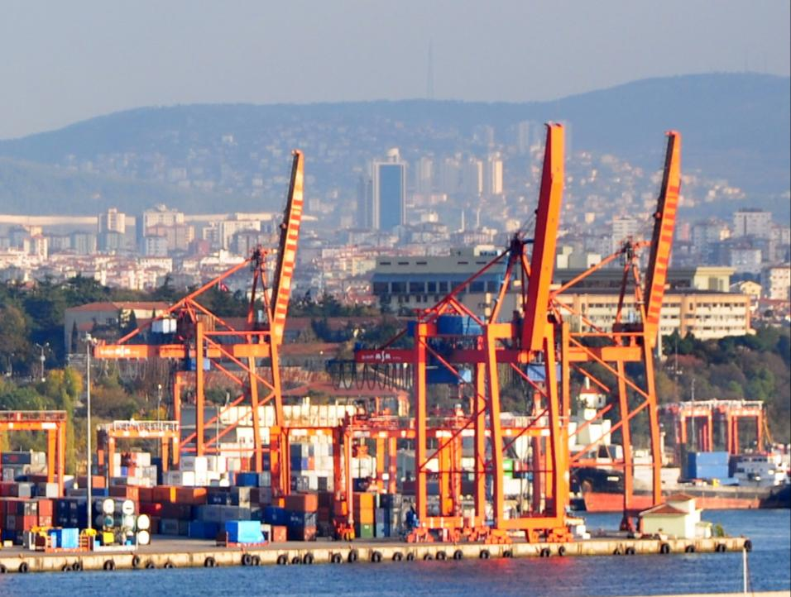
… Turkey

Slide 58
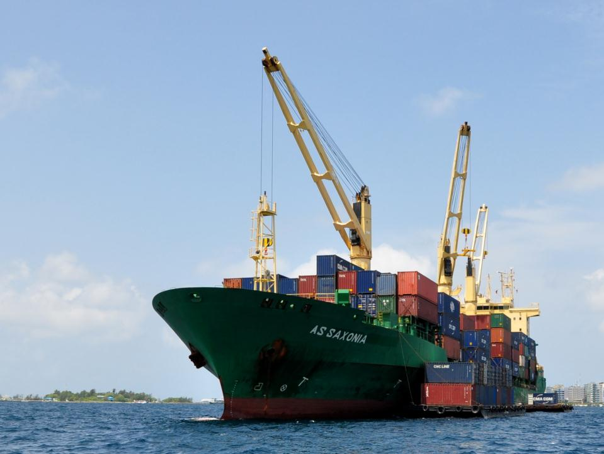
…Maldives

Slide 59
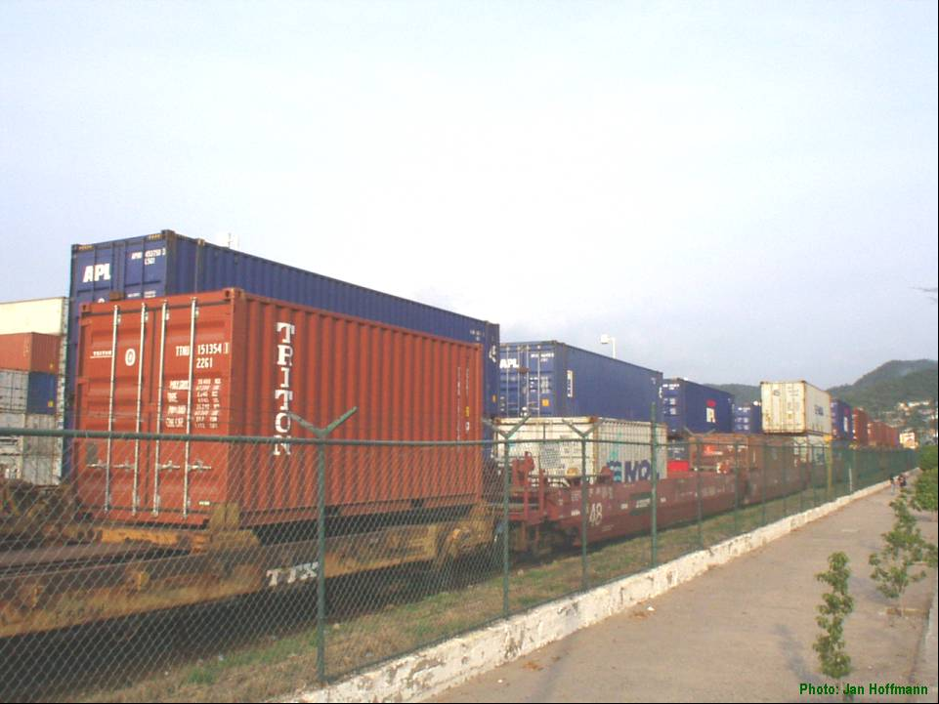
Anyhow: e.g. intermodal connections in Manzanillo, Mexico

Slide 60
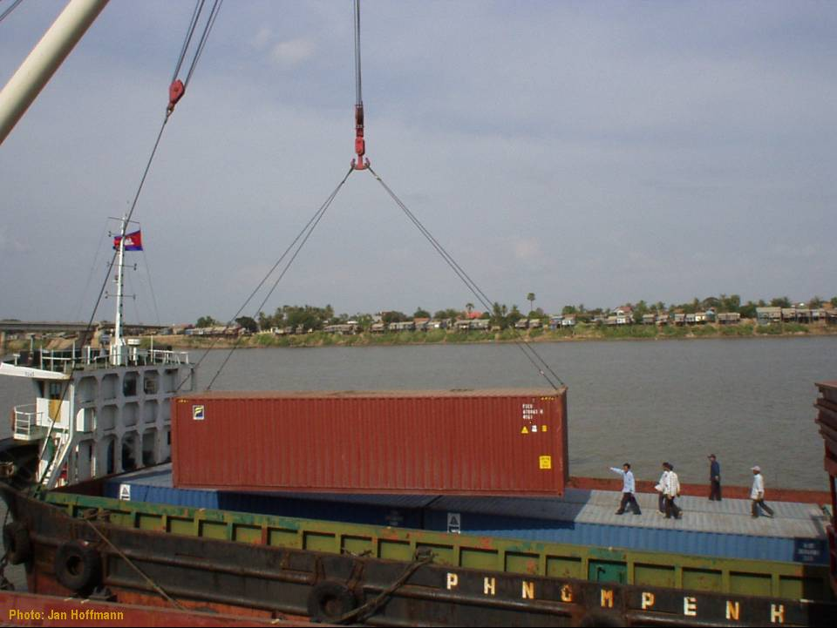
… Mekong River

Slide 61
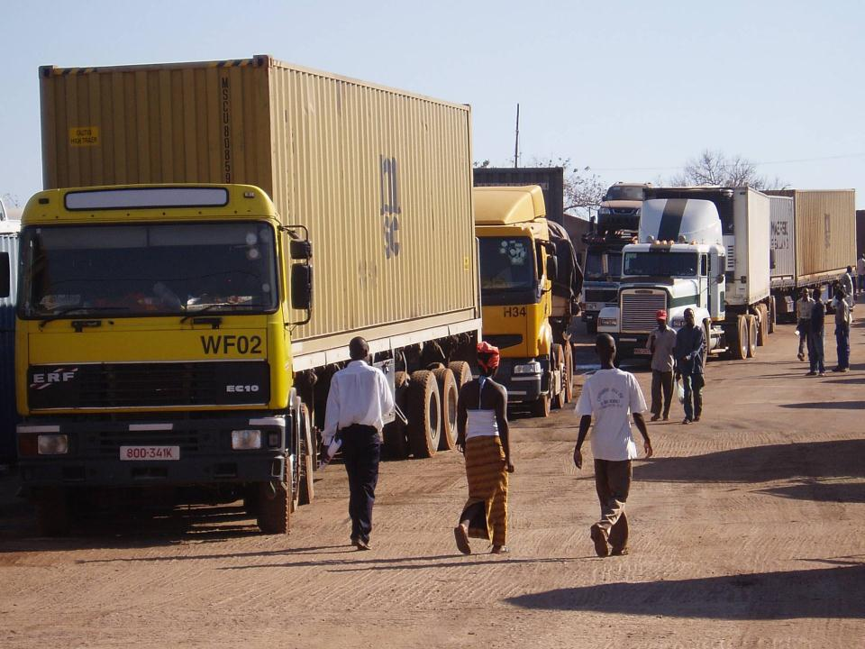
… into Zambia
Zambia

Slide 62
Technologies in international logistics
30 years ago:
Containerization
Today:
Telematics

Slide 63
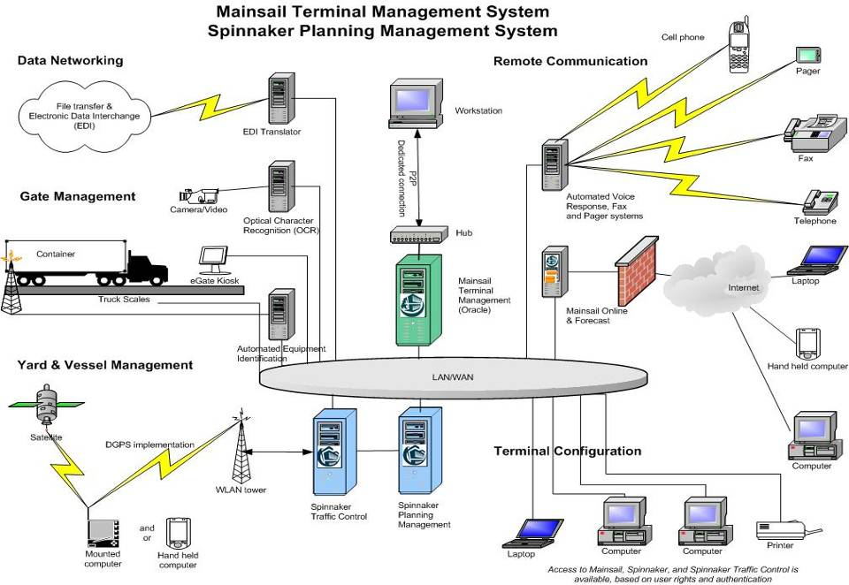
Intercambio de datos
Information exchange
Automatización
Automatización
Automation
Fuente: Michael Schwank, TOC Americas, 2004

Slide 64
Port and other Transport Community Information Systems can help…
Planning for cargo handling operations
Organizing onward transport
Improving cargo security
Tracing the status and location of cargo
Communicating with other ports
Preparing transport documents
Customs clearance
… (trade facilitation: we will talk later about)

Slide 65
Challenges affecting transport and trade of developing countries

Slide 66
Challenges affecting transport and trade
A. Transport Costs and Access to Efficient Transport Services
B. Energy, Oil Price and Shipping Costs
C. Environmental Sustainability of Transport
D. Climate Change Impacts and Adaptation in Maritime Transport
E. Security of the supply chain

Slide 67
A. Transport Costs and Access to Efficient Transport Services
Efficient access to affordable, reliable and cost effective transport systems remain an imperative condition for trade competitiveness.
Maritime freight costs have fallen globally by around 15 % over the last 20 years, but remain high for many developing countries.
For LLDCs sea shipping accounts for about 8.7 % but with long land distances to ports, delays for border crossing, actual costs may be 2-3 times higher.
In many developing regions, transport infrastructure and services remain inadequate for an effective connectivity and efficient access to global markets.

Slide 68
Average cost of transport by decade and regional groupings (% value of imports)

Slide 69
B. Energy, Oil Price and Shipping Costs
Global trade expansion has been propelled by increasingly efficient but heavily oil-dependent shipping transportation systems (80% of world trade) and not yet ready to use alternative fuel technologies.
Increases in oil prices raise the cost of shipping goods. A 10 % increase in Brent crude increases container freight rates by 1.9 - 3.6 % and tanker freight rates by 2.8% and iron ore by 10.5 %.
Over the past two years, the shipping industry has responded to rising fuel costs by adopting slow steaming. However, shippers see negative impacts on schedule reliability and service quality, which also raise transaction costs.
Sustained high oil prices will bring changes on trade flows and structure, production costs and on production plants location.

Slide 70
C. Environmental Sustainability of Transport
Freight transport is expected to grow with the growing world population, and economic growth. Transport consumes more than half of global liquid fossil fuels and is expected to account for 97 per cent of the increase of oil use between 2007 and 2030.
Transport sector, including urban and private mobility, is responsible for nearly one quarter of global energy-related carbon dioxide (CO2) emissions and for 13 per cent of all world greenhouse gas (GHG).
Today, transport sustainability is ranking high on the global policy and governmental regulatory agendas, including when addressing the special needs of the LLDCs.
The transport industry is also including sustainability as part of environmental and social considerations in Corporate Social Responsibility (CSR) programmes.

Slide 71
D. Climate Change Impacts and Adaptation in Maritime Transport
In relation to climate change, international transport, including shipping, is facing a dual challenge: to cut GHG emissions and to build its resilience in the face of factors such as sea level rise and extreme weather events.
Adaptation action in maritime transport requires re-thinking freight transport systems and integrating climate change into transport development investments design and planning.

Slide 72
E. Security
Over the last decade, international and regional transport and supply chain security measures have been proliferating. Their effective implementation raises the cost of doing business and represents an important challenge for developing countries to remain part of international transport networks.
Maritime security measures include the IMO International Ship and Port Facility Security Code (ISPS Code) mandatory on 1 July 2004. Supply-chain security measures include the WCO Framework of Standards to Secure and Facilitate Global Trade (SAFE Framework) adopted in 2005.

Slide 73
The use of ICTs in logistics, trade facilitation and supply chain security
ICTs have been in use in the Logistics services private industry for quite some time. ICTs in the Business to Governments (B2G or G2B) have only developed more recently bringing significant potential as key drivers for Trade Facilitation.
ICTs allow new types of controls such as the non-intrusive inspections of cargoes (container scanning), the provision of information prior to the arrival of the goods (pre-arrival data) and control based on risk analysis and automated selectivity.

Slide 74

Trade, Transport, Logistics and Technologies: An Introduction
Globalization
Role of transport
Role of logistics
Role of technologies
Challenges for Developing Countries
Questions?

