Slide 1
UNCTAD Programme on Non-tariff Measures in World Trade
Short courses for Permanent Missions in Geneva
21 May 2014
Christian Knebel, Alessandro Nicita, Ralf Peters and Victor Ognivtsev
Trade Analysis Branch, DITC
UNCTAD

Slide 2
UNCTAD Programme on Non-tariff Measures in World Trade
Non-tariff measures and their effects on trade and development
Definition of Non-Tariff Measures (NTMs)
Economic Effects and Importance of NTMs
UNCTAD programme on non-tariff measures and policy implications
NTM data and transparency
Analysis for Regionalism and Technical Cooperation
Research on NTMs and Trade Policy
Conclusions
Notes:
What are NTMs (in a superficial sense, understanding the idea and concept of NTMs, perhaps e.g. exporting a banana from Ecuador to EU)
Definition and Differentiating between official NTMs, procedural obstacles and private standards.
Why NTMs matter: Market structure, competitiveness, and policy dilemma
Are all regulations NTMs? Are all NTMs bad? Are they all discriminating? Reminder of some WTO rules
Measuring the economic impact of NTMs (including development, e.g. potentially unintentionally discrimination)
From measurement to policy advice: Getting things right (e.g. harmonization, mutual recognition, not only elimination)
Information gap: what information do we have and what do we need.
Test on 1 – 7 (not part of the presentation)
UNCTAD’s worldwide project to collect official NTM data: Why, where we stand, going forward.

Slide 3
Non-Tariff Measures are Most Important Trade Policy Instruments Today
Trade negotiations at multilateral and regional level with the objective to increase trade by reducing distortions of international trade
Obstacles to trade are
  Tariffs
  Quotas
  Customs rules
  Competition-related restrictions
  …
Business surveys find that Technical Measures are the most frequent barriers to trade

Slide 4
What are NTMs?
Non-tariff measures (NTMs) are
policy measures, other than ordinary customs tariffs, that can potentially have an economic effect on international trade in goods, changing quantities traded, or prices or both
NTMs can increase or decrease trade
No judgment over legitimacy or lawfulness
Notes:
A formal definition for NTMs is that „NTMs are policy measures, other than ordinary customs tariffs, that can potentially have an economic effect on international trade in goods, changing quantities traded, or prices or both “. The definition does not state that the effect on trade is negative. There are NTMs that can increase trade. A simple example is export subsidies, as mentioned before, which increase a country‘s export, but at the expense of other competing countries. Also product safety regulation can increase trade as they increase trust of consumers in the quality of foreign products. Would consumers buy imported exotic fruits if they could not be sure about the food safety or would they buy electronic devices from abroad if they would not be sure that they are technically compatible with local standards.
The definition does also not judge about the legitimacy or lawfulness of NTMs. Banning imports of animals from an infected region to prevent spreading a desease into other countries is a very legitimate objective. On the other hand misusing NTMs as a protectionist measure in disguise is not. (For example standards that go beyond international standards and that can be fulfilled by domestic producers but not foreign producers that are not scientifically justified)

Slide 5
Examples of NTMs
These are official NTMs …
Minimum import price
Import prohibitions
Product-specific quotas
Sanitary and phytosanitary requirements
Quality conditions
Import licenses
Foreign exchange market controls
Voluntary Export Restraints
Export subsidies
Export restrictions
… and these are not
Procedural obstacles
Private standards
Production standards
Inadequate infrastructure
Notes:
NTMs include a wide variety of regulations. There are so called “hard measures” which are for example price and quantity control measures, (Saudi Arabia forbids the import of alcohol for religious reasons for example); threat measures such as anti-dumping and safeguard measures (The EU had imposed provisional anti dumping tariffs on solar panels from China; China also had imposed several anti dumping tariffs); technical measures such as Sanitary and phytosanitary and technical barriers to trade measures (for example certain foodstuffs should be stored below a certain temperature; a fridge has to have a label indicating its energy consumption); as well as export related measures. Other examples are finance and rules of origin measures.
Procedural obstacles are not NTMs. Procedural obstacles are difficulties to comply with regulations not because of the strictness of the regulation but because of the way it is implemented and applied. For example long delays in testing and certifying can be a challenge. Excessive documentation requirements or demand for informal payments by officials are other examples.
Private standards as opposed to public standards are voluntary standards often found in global sourcing networks. For example large supermarket chains may have requirements that go beyond the official standards including those on the way goods are produced.
Inadequate infrastructure can also be a barrier to trade but is not considered as a NTM.
To summarize, this chapter has shown that NTMs are basically policy measures other than tariffs that can impact international trade. Various intentions can be behind NTMs including very legitimate objectives to protect health of humans. NTMs can but do not necessarily have a negative impact on trade.

Slide 6
When NTMs become NTBs...
NTM
NTM ≠ NTB
  Difficult to distinguish NTBs from NTMs
Non-tariff barriers are
policy measures that surely affect quantity traded and prices and have proven discriminatory effects against foreign firms
NTB
Notes:
Lack of transparency & openness
Discriminatory treatment (remanufactured, forestry)
Overly stringent TR (chemicals, textile labeling)
Burdensome & duplicative conformity assessment procedures for low-risk products (auto, electro)
Non-recognition of international standards – diversity across jurisdictions (auto, electro)

Slide 7
NTMs vs. NTBs
These are NTMs …
Sanitary and phytosanitary requirements based on scientific evidence
Documentation: Certificate of origin, etc
Licenses used to verify compliance with safety rules
Regulation of the fireproof properties of electric wire insulation material
… and these are NTBs
Excessively stringent regulations
SPS measures without a scientific basis
Licenses used to restrict imports
Quotas
Prohibitions for purposes other than protecting the environment or health
Forcing importers to use a State-owned transit company
Notes:
WTO disciplines provide useful guide to tell NTBs vs. NTMs
Necessity
Proportionality
Non discrimination (national treatment)

Slide 8
UNCTAD Non-Tariff Measure Programme
Working along the entire value chain
Conception
classification data
selection
Data collection
classifying NTMs
quality control
Data
Dissemi-nation
making data freely available
Research and analysis
Support to Policy Makers and policy making processes
Guides the concept and data collection

Slide 9
UNCTAD Programme on Non-tariff Measures in World Trade
Non-tariff measures and their effects on trade and development
Definition of Non-Tariff Measures (NTMs)
Economic Effects and Importance of NTMs
UNCTAD programme on non-tariff measures and policy implications
NTM data and transparency
Analysis for Regionalism and Technical Cooperation
Research on NTMs and Trade Policy
Conclusions
Notes:
What are NTMs (in a superficial sense, understanding the idea and concept of NTMs, perhaps e.g. exporting a banana from Ecuador to EU)
Definition and Differentiating between official NTMs, procedural obstacles and private standards.
Why NTMs matter: Market structure, competitiveness, and policy dilemma
Are all regulations NTMs? Are all NTMs bad? Are they all discriminating? Reminder of some WTO rules
Measuring the economic impact of NTMs (including development, e.g. potentially unintentionally discrimination)
From measurement to policy advice: Getting things right (e.g. harmonization, mutual recognition, not only elimination)
Information gap: what information do we have and what do we need.
Test on 1 – 7 (not part of the presentation)
UNCTAD’s worldwide project to collect official NTM data: Why, where we stand, going forward.

Slide 10
The impact of NTMs on trade
NTMs are very diverse and so is their impact on trade
  Add Costs to Trade
    Standards require Information and Compliance
  Preclude trade
    Prohibitions, stringent requirements
  Divert Trade
    Quotas, Standards
  Create Trade
    SPS and TBT (guarantee products and unify markets)

Slide 11
Reasons why NTMs are imposed
Monitoring Trade and Trade Policy
GOOD REASONS. Indeed, most of the NTMs are there for public policy responsibility or to address market failures
Protect and inform consumers (SPS TBT)
Protect the environment (TBT)
Guarantee quality (TBT)
Regulate domestic markets (Pricing, Licenses)
Avoid unintended spillovers of PTAs (ROO)

Slide 12
Reasons why NTMs are imposed
NOT-SO-GOOD Reasons
NTMs are used for protectionist intent
  Protect inefficient domestic industries
  Favor some foreign exporters relative to others
Overregulating a market
  add unnecessary burdens to the production and trade
Ultimately whether NTMs are good or not-so-good depends on whether the benefits are larger than the costs Efficient NTMs frameworks maximize benefits at the lowest social costs

Slide 13
Effects of NTMs: Benefits and Costs
NTMs as many policies have distributive effects
  Winners and losers depends from the point of view
  Benefit can accrue to few at the expenses of many and vice-versa.
Correct approach in assessing NTMs is not only to look at trade effects but to the overall economy
  Increasing Efficiency
  Fostering Competition
  Aligning with Development / Industrial Policy Strategy
  Spillovers into Social Welfare

Slide 14
Costs and Benefits of Standards
  Example: Foodstuff should be subject to traceability
Costs:
  Increased costs
  Increased prices
  Higher entry costs
  Lower competition
Benefits:
  Safer products
  Higher quality products
  Intermediates are made to specifications
  Trade Effects: Increases demand/trade because product is deemed safer. Reduce/distort trade to favor some producers

Slide 15
Costs and Benefits of Subsidies
  Example: Dairy farmers receive subsidies to help them stay in business.
Costs:
  Shift resources
  Decrease overall efficiency of the economy
  Beggar-thy-neighbor
Benefits:
  Help domestic producers
  Increase availability of products
  Lowers prices
  Trade Effects: Raises overall production, distort international trade, lowers international prices.

Slide 16
Costs and Benefits of Quotas
  Example: Sugar tariff rate quota’s.
Costs
  Higher domestic prices
  Possible Shortages
Benefits
  Domestic industry protection
  Economic Policy Instrument (PTAs)
  Trade Effects: Distort trade to favor domestic or specific foreign producers.

Slide 17
How large are Trade effects?
All considered, NTMs significantly add to trade costs.

Slide 18
Why are the Trade effects so large?
Cost of compliance can be high (Standards, TRQ)
The use of NTMs is increasing and widespread

Slide 19
NTMs is particularly problematic for LIC
  Even if NTMs are uniformly applied, cost of compliance is often higher for firms operating in low income countries (standards)
  SME that cannot meet fix costs may cut off from markets (standards)
  NTMs are more common in goods exported by low income countries (agriculture, apparel) (quotas, standards)
  Inefficient ways of protecting domestic markets (price mechanisms)

Slide 20
UNCTAD Programme on Non-tariff Measures in World Trade
Non-tariff measures and their effects on trade and development
Definition of Non-Tariff Measures (NTMs)
Economic Effects and Importance of NTMs
UNCTAD programme on non-tariff measures and policy implications
NTM data and transparency
Analysis for Regionalism and Technical Cooperation
Research on NTMs and Trade Policy
Conclusions
Notes:
What are NTMs (in a superficial sense, understanding the idea and concept of NTMs, perhaps e.g. exporting a banana from Ecuador to EU)
Definition and Differentiating between official NTMs, procedural obstacles and private standards.
Why NTMs matter: Market structure, competitiveness, and policy dilemma
Are all regulations NTMs? Are all NTMs bad? Are they all discriminating? Reminder of some WTO rules
Measuring the economic impact of NTMs (including development, e.g. potentially unintentionally discrimination)
From measurement to policy advice: Getting things right (e.g. harmonization, mutual recognition, not only elimination)
Information gap: what information do we have and what do we need.
Test on 1 – 7 (not part of the presentation)
UNCTAD’s worldwide project to collect official NTM data: Why, where we stand, going forward.

Slide 21
UNCTAD Non-Tariff Measure Programme
Working along the entire value chain
Conception
classification data
selection
Data collection
classifying NTMs
quality control
Data
Dissemi-nation
making data freely available
Research and analysis
Support to Policy Makers and policy making processes
Guides the concept and data collection

Slide 22





Transparency
Strong need and demand for transparency in trade policy per se:
Internationally coordinated effort
→ UNCTAD leads collection of official NTMs
Additional cooperation with WTO to complement notifications
Access to NTM data for:
  Exporters/importers
  Policy makers
  Researchers
Notes:
Programme to build, update and disseminate free of charge
trade policy databases, including NTMs

Slide 23
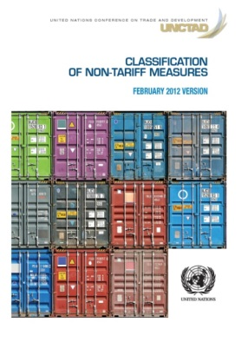
A common language:
UNCTAD-MAST NTM Classification:
Multi Agency Support Team (FAO, IMF, ITC, OECD, UNCTAD, UNIDO, World Bank, WTO) initiated by UNCTAD SG developed NTM classification
Notes:
1st essential step towards transparency!!!

Slide 24
UNCTAD-MAST NTM Classification
Tree structure – Example
A SANITARY AND PHYTOSANITARY MEASURES
A1 Prohibitions
/
restrictions of
imports for SPS reasons
A2 Tolerance limits for residues and restricted use of substances
(…)
A8
Conformity Assessment
related to SPS
A81 Product registration requirement
A82 Testing requirement
At this level of coding: 122 measures in the classification
A83 Certification requirement
A84 Inspection requirement
A85 Traceability requirement
A851 Origin of materials and parts
A8
5
2 Proces
sing history
A853 Distribution
and location
of products after
delivery
A859 Traceability requirements n.e.s.
A86 Quarantine requirement
A89 Conformity assessments related to SPS n.e.s
A9 SPS
Measures n.e.s.
B TECHNICAL BARRIERS TO TRADE
C
PRE
-
SHIPMENT INSPECTION AND OTHER FORMALITIES
D
CONTINGENT TRADE PROTECTIVE MEASURES
E
NON
-
AUTOMATIC LICENSING, QUOTAS, PROHIBITIONS …
F
PRICE
CONTROL
MEASURES INCLUDING
ADDIT
.
TAXES
…
G FINANCE ME
ASURES
H MEASURES
AFFECTING COMPETITION
I TRADE
-
RELATED INVESTMENT MEASURES

Slide 25
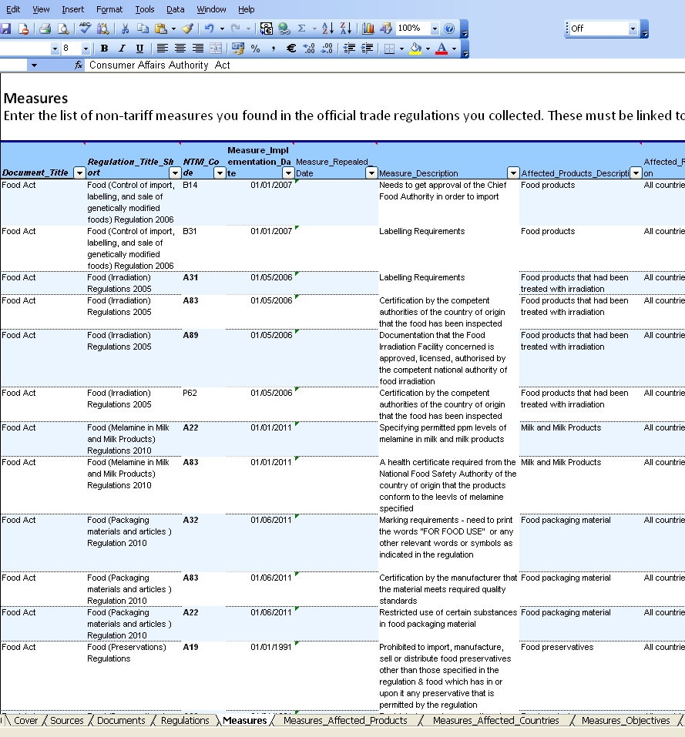
Official NTM data collection
From here… …to here

Slide 26



Transparency: comprehensiveness, comparability and accessibility
Comprehensiveness:
  All currently applied measures
  Official governmental sources
Comparability:
  Same data collection approach used for all countries
  Data quality checking done by UNCTAD
  Revision of methodology and quality assurance in 2012
Accessibility:
  NTMs classified
  Products classified by Harmonized System (HS)
  Affected countries
  Full regulation detail
Notes:
Pile of regulations: can come from different ministries and institutions; from any year in the past.

Slide 27
Data Availability (More countries in the pipeline)
Objective: Cover NTMs for 90 per cent of World Imports by 2015
Latin America and the Caribbean | North America | Europe and Central Asia | Middle East and North Africa | Sub-Saharan Africa | South Asia | East-Asia and the Pacific
Argentina | US | E.U. | Egypt | Burkina Faso | Afghanistan | China
Bolivia | Canada | Kazakhstan | Lebanon | Cote d’Ivoire | (India) | Japan
Brazil |  | Russia | Morocco | Guinea | Nepal | Lao PDR
Chile |  |  | Tunisia | Madagascar | Pakistan | Australia
Colombia |  |  |  | Mauritius | Sri Lanka | New Zealand
Costa Rica |  |  |  | Namibia
Cuba |  |  |  | Senegal |  | ASEAN
Ecuador |  |  |  | Tanzania
Guatemala |  |  |  | Kenya
Mexico |  |  |  | Malawi
Paraguay |  |  |  | (ECOWAS)
Peru
Uruguay |  |  |  | SADC
Venezuela |  |  |  | EAC / COMESA

Slide 28

How to access data
http://wits.worldbank.org/wits/
Notes:
.

Slide 29

NTM online training for data collectors
    Primer to NTMs
    Classification NTMs
    Classification of NTMs in HS Product Code
    Guidelines to Data collection
    Data Classification and storage: Template and WITS Access
→Increase efficiency and
consistency of data collection

Slide 30
Feeding data into technical cooperation:
Support for “deep” regional integration
Support for regional groups in systematically addressing NTMs; ongoing pilot for SADC/ALADI
Technical cooperation based on sound research and analysis → NTM data crucial
Different target audiences:
  High level policy makers:
  Raise awareness and political will → Welfare analysis
  Technical level:
  Analyze specific regulatory differences in a region
  Also: Institutional/legal analysis

Slide 31
Support for “deep” regional integration:
1. Welfare impact of NTMs on poor households
Analytical approach based on household surveys and NTM data
Effect of SPS measures on total expenditure of households:
  Richest 5%: 7%
  Poorest 5%: 9%
Distributional effect
Benefits of SPS remain

Slide 32
Support for “deep” regional integration:
2. Assessing regulatory differences
Data-based mapping
of regulatory distance
→ potential for
harmonization,
identification of
priority sectors and
countries
In depth analysis of regulations at the product level
➔ Regional harmonization of NTMs;
not elimination of SPS/TBT

Slide 33
UNCTAD Programme on Non-tariff Measures in World Trade
Non-tariff measures and their effects on trade and development
Definition of Non-Tariff Measures (NTMs)
Economic Effects and Importance of NTMs
UNCTAD programme on non-tariff measures and policy implications
NTM data and transparency
Analysis for Regionalism and Technical Cooperation
Research on NTMs and Trade Policy
Conclusions
Notes:
What are NTMs (in a superficial sense, understanding the idea and concept of NTMs, perhaps e.g. exporting a banana from Ecuador to EU)
Definition and Differentiating between official NTMs, procedural obstacles and private standards.
Why NTMs matter: Market structure, competitiveness, and policy dilemma
Are all regulations NTMs? Are all NTMs bad? Are they all discriminating? Reminder of some WTO rules
Measuring the economic impact of NTMs (including development, e.g. potentially unintentionally discrimination)
From measurement to policy advice: Getting things right (e.g. harmonization, mutual recognition, not only elimination)
Information gap: what information do we have and what do we need.
Test on 1 – 7 (not part of the presentation)
UNCTAD’s worldwide project to collect official NTM data: Why, where we stand, going forward.

Slide 34
Research projects related to NTMs (1)
Quantify the impact of NTMs on the cost of trading
Question
  How much NTMs add to the cost of trading?
Why
  Providing evidence on the importance of some types of NTMs and for some countries.
  Identify NTMs and trade flows where costs are higher
Output
  Ad-Valorem Equivalents of NTMs
  Feed into policy modeling
  Direct policy actions and recommendations

Slide 35
Research projects related to NTMs (2)
Better understand distortionary effects of NTMs
Question
  How different are NTMs related costs across countries and firms?
Why is important
  Distortionary impacts go against more vulnerable countries.
  Useful for addressing NTMs in PTAs
Output
  Better understand trade diversion effects
  Impact of NTMs for PTAs and non-members countries
  Feed into policy dialogue and better direct TF AfT.

Slide 36
Research projects related to NTMs (3)
NTMs and Market Access to developed countries
Question
  How NTMs affects LIC exports to developed countries?
Why
  Developed countries markets are most important for LIC.
  NTMs and value addition
Output
  Identify sectors where NTMs are most restrictive
  Direct policy, N-S negotiations and AfT.

Slide 37
Policy Output (1)
How to deal with NTMs in the MULTILATERAL system
TRADE ISSUES
Measures with a evident protectionist intent
  Removal of protectionist measures in the appropriate fora
Non protectionist measures:
  Harmonization of standards, custom procedures, mutual recognition principle (Negotiations in PTA, RTA, WTO)
Other measures not negotiable within PTA.
  Technical Assistance in production and export processes
Costs associated with NTMs could be covered by:
  Aid for Trade, Technical assistance (development assist.)
  Partnership agreements (mutual interest within PTA)
  Global chains investments (profit driven)

Slide 38
Policy output (2)
Domestic Reforms and NTMs
NON-TRADE ISSUES
Principle of efficient regulations: policy effort is critical to ensure that NTMs serve their intended legitimate purposes.
Efficient regulations are essential for addressing domestic concerns while not decreasing competitiveness
NTMs can have large spillovers on economic efficiencies and therefore should be precisely targeted to the market failures they are trying to correct

Slide 39
UNCTAD Programme on Non-tariff Measures in World Trade
Non-tariff measures and their effects on trade and development
Definition of Non-Tariff Measures (NTMs)
Economic Effects and Importance of NTMs
UNCTAD programme on non-tariff measures and policy implications
NTM data and transparency
Analysis for Regionalism and Technical Cooperation
Research on NTMs and Trade Policy
Conclusions
Notes:
What are NTMs (in a superficial sense, understanding the idea and concept of NTMs, perhaps e.g. exporting a banana from Ecuador to EU)
Definition and Differentiating between official NTMs, procedural obstacles and private standards.
Why NTMs matter: Market structure, competitiveness, and policy dilemma
Are all regulations NTMs? Are all NTMs bad? Are they all discriminating? Reminder of some WTO rules
Measuring the economic impact of NTMs (including development, e.g. potentially unintentionally discrimination)
From measurement to policy advice: Getting things right (e.g. harmonization, mutual recognition, not only elimination)
Information gap: what information do we have and what do we need.
Test on 1 – 7 (not part of the presentation)
UNCTAD’s worldwide project to collect official NTM data: Why, where we stand, going forward.

Slide 40
Reasons to Address NTMs
Large and uneven costs of trading
  Domestic and multilateral policy actions to reduce costs
  NTMs can be particularly damaging for LIC participation in international trade
Most NTMs cannot easily be eliminated
  Most NTMs have important objectives
  Often difficult to single out NTBs from NTMs
  NTMs can create rents

Slide 41
More reasons
The use of NTMs is increasing
Consumers Demand for quality is rising everywhere
Developing countries use of standards is increasing
Global Value Chains need standards
The rising number of quality and product standards is also driven by concerns about information, coordination and traceability
Private standards and national standards
NTMs can be used for effective but hidden protectionism
Countries: Use of NTMs spikes in countries in crisis
Firms: GVCs use standards to obtain market power

Slide 42
Why UNCTAD work on NTM is important?
Close Transparency gap: UNCTAD lead organization on global NTM mapping
Raise Awareness – NTMs implications for development strategies (e.g. export led growth)
Provide Training – Identify and assess NTMs
Inform countries Trade Strategies and support Trade Negotiations – NTMs fit in the overall trade policy framework (multilateral, regional; harmonization, mutual recognition)
Address Domestic Reforms – Create an efficient regulatory framework

Slide 43
Contact: tab@unctad.org

