Slide 1
Trade and Gender Nexus in the Context of Regional Integration:
A Comparative Assessment of the EAC and Mercosur
Nursel Aydiner Avsar
UNCTAD - DITC
Trade, Gender and Development Programme
2 November 2018, Geneva

Slide 2
Outline
Historical origins and cornerstones of regional integration
Socioeconomic Profiles
Gender-related legal, institutional and policy framework
  International, regional, national levels
  Gender mainstreaming in trade policy
Gender inequalities in different domains of economic life
  Education
  Employment
  Access to resources
Gender employment effects of regional integration
How to make trade policy gender-sensitive: A policy framework for the EAC

Slide 3
Historical Origins and
Cornerstones of Regional Integration
East African Community (EAC)
Founded on 7 July 2000
The Customs Union Protocol (March 2004)
The Common Market Protocol (November 2009)
The Monetary Union Protocol (November 2013)
The establishment of an East African Federation (in process)
Southern Common Market (Mercosur)
Founded on 26 March 1991
The Customs Union Treaty (December 1994)
Common Market (January 1995)
Both economic and political considerations

Slide 4
Socioeconomic Profiles:
Basic economic and social indicators
 | EAC | Mercosur | Sub-Saharan Africa | Latin America & Caribbean
GDP (billion) | 148.4 | 2815.5 | 1748.5 | 6026.8
GDP per capita | 2345 | 14862 | 3459 | 14412
Population (million) | 173 | 264 | 1061 | 644
Population density (people per sq. km) | 161.0 | 23.3 | 44.9 | 32.1
Gini index | 42.6 | 49.6
Poverty ratio at $1.90 a day (2011 PPP) (% of population) | 46.2 |  | 42.3
Poverty ratio at $5.50 a day (2011 PPP) (% of population) |  | 17.3 |  | 27.1
Source: World Bank, World Development Indicators database

Slide 5
Socioeconomic Profiles:
Sectoral structure of GDP
Source: UNCTADStat database

Slide 6
Legal and Institutional Framework for Gender Equality
EAC
Conventions on promoting gender equality, CEDAW
Constitutions + ministries on gender
The EAC Gender Equality and Development Bill (8 March 2017)
Articles in the EAC treaty
Legal setting
National trade policy
Mercosur
Conventions on promoting gender equality, CEDAW
Constitutions + ministries/bodies on gender
CCSCS-MERCOSUR Women’s Commission (1997)
Specialized Meeting of Women (REM) (1998)
Women’s Meeting of Ministers and High Authorities (RMAAM) (2011)
MERCOSUR Policy Guidelines for Gender Equality (2014)
Legal setting
National trade policy

Slide 7
Education: School Enrolment
Source: World Bank, World Development Indicators database

Slide 8
Employment: Sectoral Composition
Source: ILOStat database

Slide 9
Employment: Work Status
Source: ILOStat database

Slide 10
Gender characteristics of employment in each broad sector
Agriculture
  Gender productivity gap
  Export and staple cash crops
Manufacturing
  Manufacturing’s share in male and female employment
  ↑ in the EAC and ↓ in Mercosur.
  «feminisation of labour» only in the EAC (women’s share in manufacturing employment ↑)
Services
  Women in Mercosur: Wholesale and retail trade & Services related to domestic work => high informality
  Women in EAC: Wholesale and retail trade & tourism => ICBT, low-skilled jobs

Slide 11
Access to Resources: Credit
Source: World Bank, The Global Findex database 2017

Slide 12
Access to Resources: Land
Source: FAO, Gender and Land Rights database

Slide 13
Gender Employment Effects of Regional Integration
Tariff liberalization in export markets:
  (+) effect on women’s employment share in manufacturing firms across the EAC (except Burundi) and Mercosur (except Brazil)
  => only for production workers
  Trade integration and technological upgrading vs.
  Source of competitive advantage
Import tariff liberalization (import competition):
  (-) effect on women’s employment share in production tasks in the EAC overall.
  (-) effect on women’s employment share
    in production tasks in Brazil and Uruguay
    in non-production tasks in Argentina and Paraguay

Slide 14
Gender Employment Effects of Regional Integration
Results by trading partners:
  EAC: similar but smaller (+) effect of tariff liberalization in the Asia-Pacific and EU markets
  => Only for production workers
  Mercosur: (+) effect of tariff liberalization in Latin American markets; (-) effect in North American markets
  => Only for production workers
Expansion of exports over time seems to create jobs for women only in low-skilled and lower-paying jobs, most of which are blue-collar, in both regions.

Slide 15
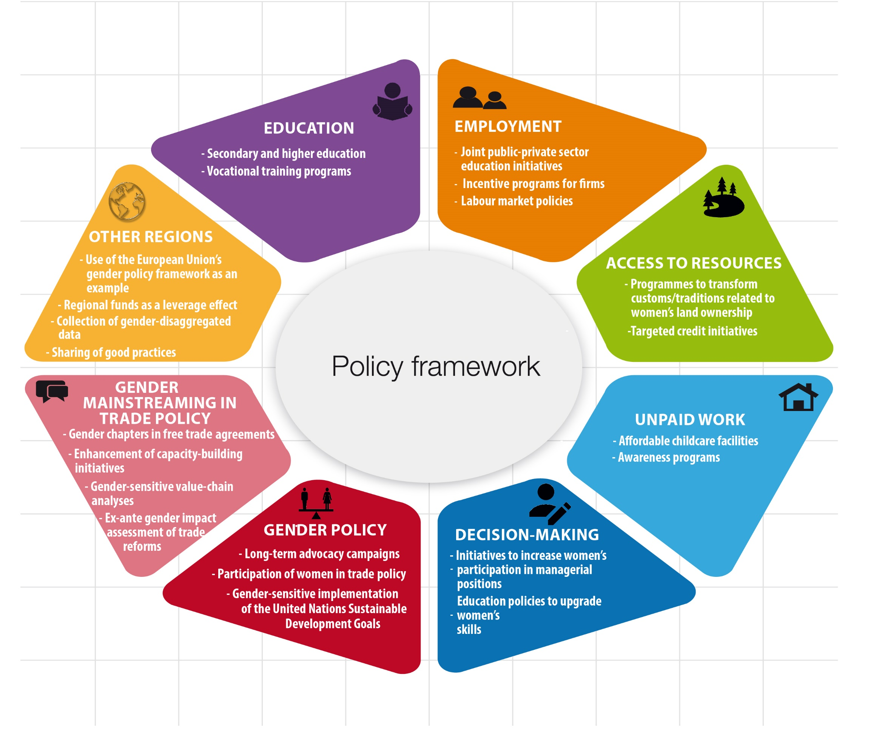

Slide 16
Policy Recommendations
Education
Access to secondary and tertiary education
Vocational training programs
Joint public-private sector educational initiatives
Employment
Targeted input subsidies, technological investments, and extension and advisory services
Protection against gender-based discrimination in the labour market
Employment offices
Incentive programs for firms to open up to international markets and achieve certification

Slide 17
Policy Recommendations
Access to resources
Gender-equitable land tenure governance
Country-level credit initiatives may need to be reconceived
Regional credit mechanism
Unpaid care and domestic work burden
Affordable childcare facilities
Education programmes to transform the established division of labour in the society

Slide 18
Policy Recommendations
Decision-making
Participation in top managerial positions in firms
  Use of online talent pools of women
Gender policy at the national and regional level
The EAC Gender Equality and Development Bill =>
  to introduce a region-wide approach to long-term advocacy campaigns for gender equality
Participation in trade policy processes
Gender-sensitive implementation of SDGs

Slide 19
Policy Recommendations
Gender mainstreaming in trade policy
Gender chapters in recent FTAs as good examples
Ex-ante gender impact assessment of trade reforms
Trade-focused capacity building programmes
Gender-sensitive value-chain analysis
Learning from gender mainstreaming in other regions
The European Union’s gender policy framework as a good example
Regional funds as a leverage effect
Uniform collection of gender-disaggregated data
Platforms to exchange good practices and peer learning

Slide 20
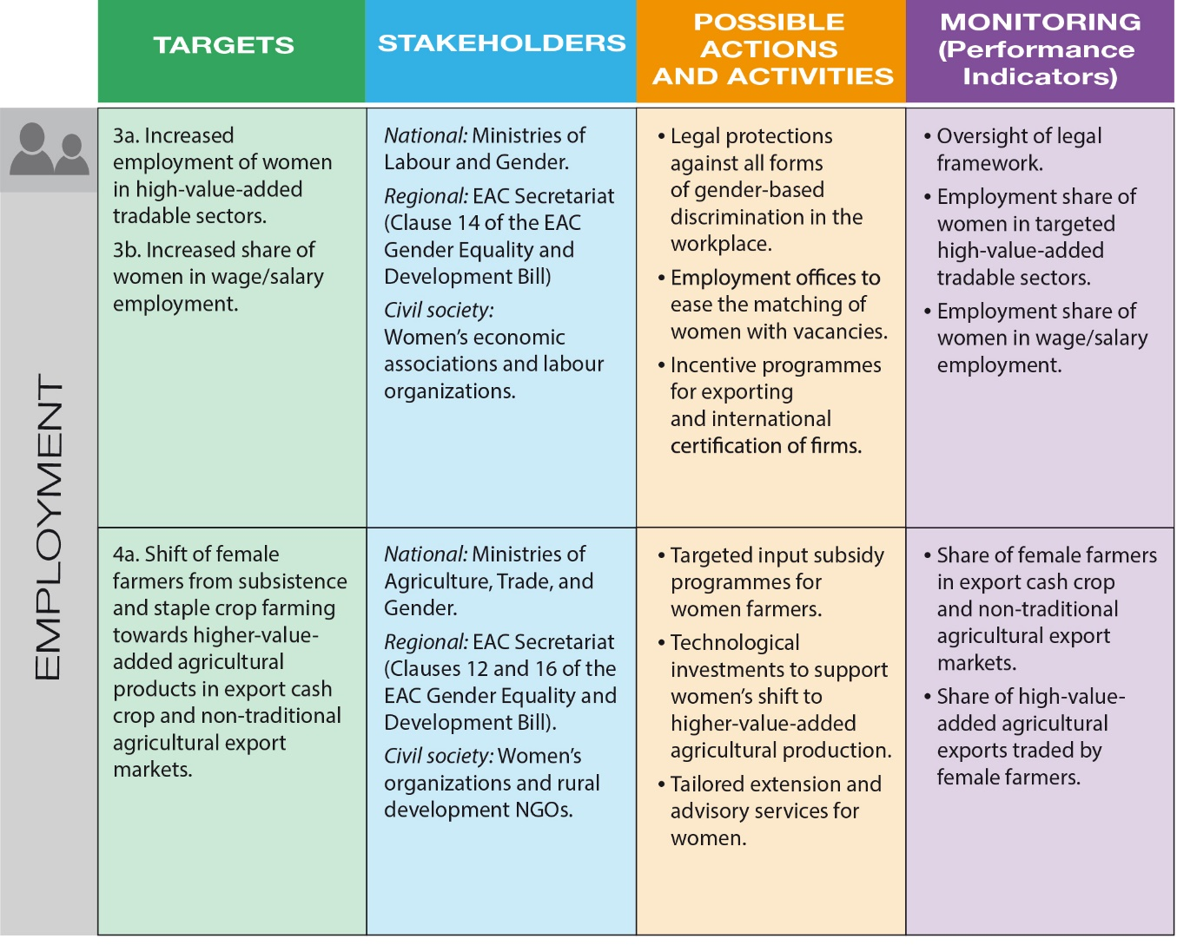

Slide 21
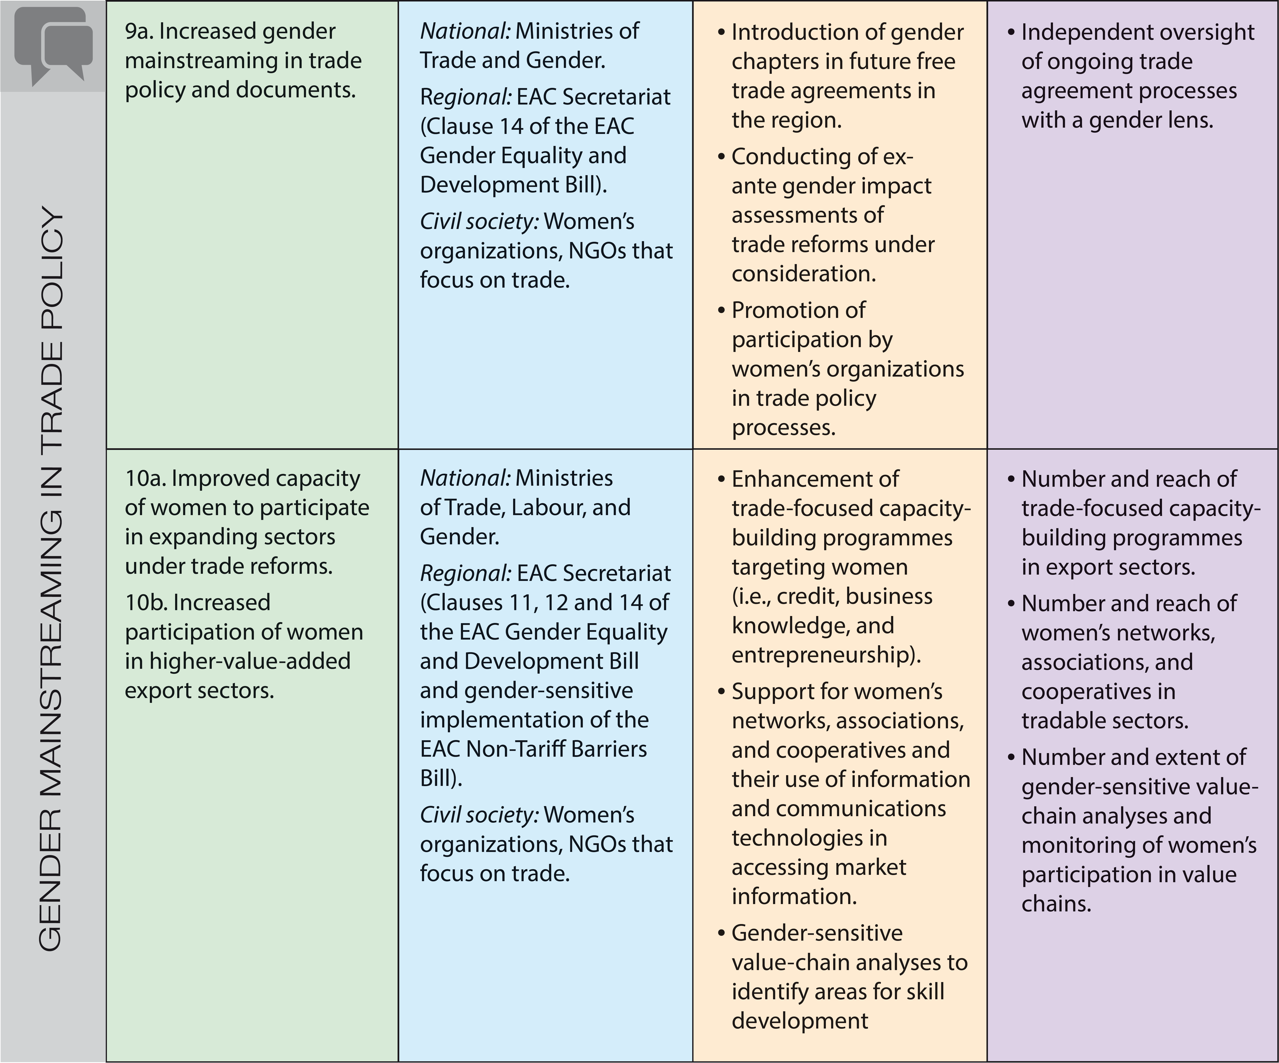

Slide 22


Thank you for your attention
http://UNCTAD.org/gender
gender@unctad.org
https://twitter.com/unctadgender

