Slide 1
TRADE REGULATIONS IN THE 21ST CENTURY:
Non-tariff measures, trade costs and sustainable development
P166 SHORT COURSES
Bonapas Onguglo
Ralf Peters
Alessandro Nicita
Christian Knebel
Trade Analysis Branch
Division on International Trade and Commodities
wisdom
knowledge
data
information

Slide 2

Non-Tariff Measures everywhere …

Slide 3










Baobab (Adansonia Digitata L)
FACTS:
Found mostly in Southern Africa
Certain natural habitats under pressure
Marginalized regions – extreme poverty
Iconic – Known as the tree of life
Fruit rich in antioxidants, magnesium, vitamin C
Use by food and cosmetics industries
New income potential to around 2.5 million people
Economic incentives to protect species / habitats

Slide 4
Requirements for export of new fruit to EU
WHAT IS NEEDED?
I. Specification of the food
II. Effect of the production process applied to the food
III. History of the organism used as the source of the food
IV. Specificity of expression of novel genetic material*
V. Ability of the material to survive in and colonize the human gut*
VI. Anticipated intake/extent of use of the food
VII. Information from previous human exposure to the food or its source
VIII. Nutritional information on the food*
IX. Microbiological information on the food*
X. Toxicological information on the food*
Example for Baobab fruit
APPROXIMATE TOTAL COST:
500,000 – 1’000,000 EUR
UP TO 5 YEARS FOR APPROVAL
* Done by recognized lab (i.e. in the EU)
Source: UNCTAD BioTrade Initiative

Slide 5
UNCTAD NTM Programme unctad.org/ntm
Transparency
Good Regulations
Conception
classification
data
selection
Data collection
classifying NTMs
quality control
Data
Dissemi-nation
making data freely available
Research and analysis
Policy
Support to Policy Makers and policy making processes
Guides the concept and data collection

Slide 6
Outline
Introduction into Non-Tariff Measures
Non-tariff measures and economic development
NTMs and social and environmental SDGs
What can be done …

Slide 7
Non-Tariff Measures
“Non-Tariff Measures are policy measures, other than ordinary customs tariffs, that can have an effect on international trade …” (UNCTAD Group of Eminent Persons on NTBs)
NTMs include a broad range of policy instruments including
  traditional trade policy instruments, such as quotas and price controls, and rules of origin as well as
  regulatory and technical measures that stem from important non-trade objectives related to health and environmental protection
    Sanitary and Phytosanitary (SPS) measures and
    Technical Barriers to Trade (TBT)

Slide 8
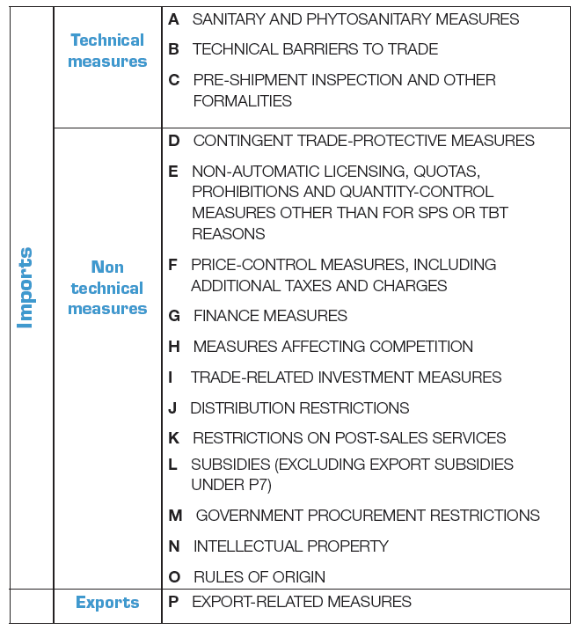
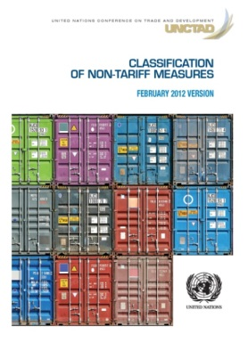
International Classification of NTMs:
The common language
Multi Agency Support Team
(FAO, IMF, ITC, OECD, UNCTAD, UNIDO,
World Bank, WTO)
updated UNCTAD NTM classification

Slide 9
MAST NTM Classification
Tree structure – Example
A SANITARY AND PHYTOSANITARY MEASURES
A1 Prohibitions
/
restrictions of
imports for SPS reasons
A2 Tolerance limits for residues and restricted use of substances
(…)
A8
Conformity Assessment
related to SPS
A81 Product registration requirement
A82 Testing requirement
At this level of coding: 177 measures in the classification
A83 Certification requirement
A84 Inspection requirement
A85 Traceability requirement
A851 Origin of materials and parts
A8
5
2 Proces
sing history
A853 Distribution
and location
of products after
delivery
A859 Traceability requirements n.e.s.
A86 Quarantine requirement
A89 Conformity assessments related to SPS n.e.s
A9 SPS
Measures n.e.s.
B TECHNICAL BARRIERS TO TRADE
C
PRE
-
SHIPMENT INSPECTION AND OTHER FORMALITIES
D
CONTINGENT TRADE PROTECTIVE MEASURES
E
NON
-
Available at
unctad.org/ntm
Classification
AUTOMATIC LICENSING, QUOTAS, PROHIBITIONS …
F
PRICE
CONTROL
MEASURES INCLUDING
ADDIT
.
TAXES
…
G FINANCE ME
ASURES
H MEASURES
AFFECTING COMPETITION
I TRADE
-
RELATED INVESTMENT MEASURES

Slide 10
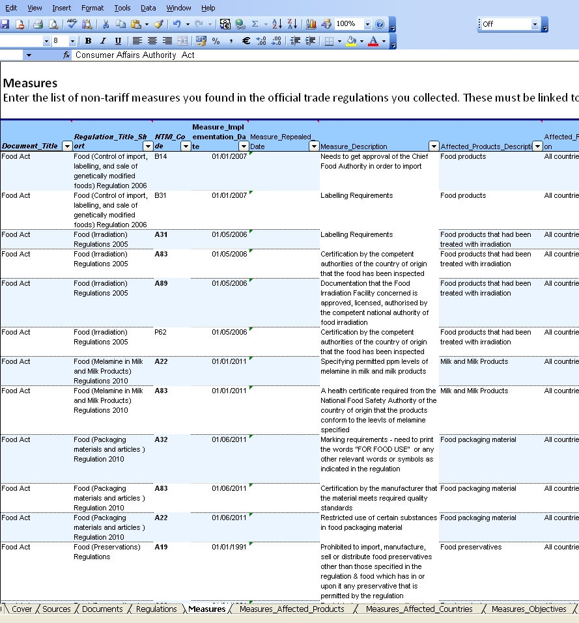
Official NTM data collection
From here… …to here

Slide 11
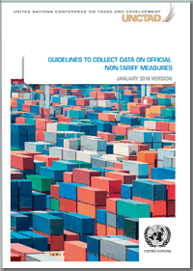
Data collection process: quality and standardization
Thorough data collection process
Local partner
Online training with test
(only certified data collectors)
Face-to-face training
Partner in government
Quality controller in UNCTAD
Validation workshop

Slide 12















Map of Data Availability – A global initiative
UNCTAD coordinates the global NTM data collection done in collaboration with more than 10 agencies
Data available at
Trains.unctad.org
Wits.worldbank.org

Slide 13
Information collected
Basic statistical information
Source of the regulation
Type of NTM
Associated product/s (HS6 of tariff line)
Country imposing the measure
Country/ies to which the measure is imposed
But also available
Date entry into force
Name of legal text
Text description of the requirement
Government department responsible
Other… 67 variables

Slide 14
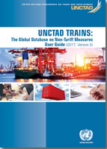
Data user guide: strength and limitations of data
How to read and use the data
Easy to use for private sector
Understanding all variables for more needs
How to read the data
How to use the data
Difference to WTO notification data
…

Slide 15
Outline
Introduction into Non-Tariff Measures
Non-tariff measures and economic development
NTMs and social and environmental SDGs
What can be done …

Slide 16
UNCTAD publication:
Non-tariff Measures. Economic Assessment and Policy options for Development
Handbook: tools and methods for assessing the implication of NTMS
Part of Development Account Project:
  Strengthening capacities of policy-makers to assess implications of NTMS…

Slide 17
UNCTAD publication:
The unseen impact of Non-Tariff measures
Analysis of new UNCTAD database, assessment and some policy implications
Published in collaboration with the WORLD BANK

Slide 18
NTM are becoming very prominent
Trends: tariffs and non-tariffs measures

Slide 19
Cumulative notifications at the WTO
Not including measures notified before 2003, and assuming very conservative 25% expiration rate

Slide 20
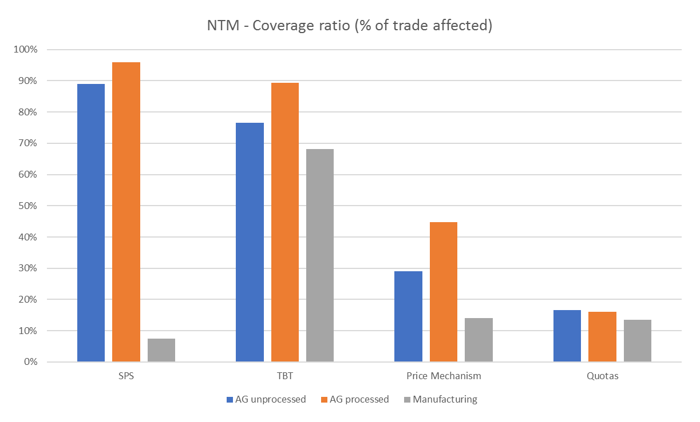
Prevalence of NTMs, Agriculture vs Mfg.

Slide 21
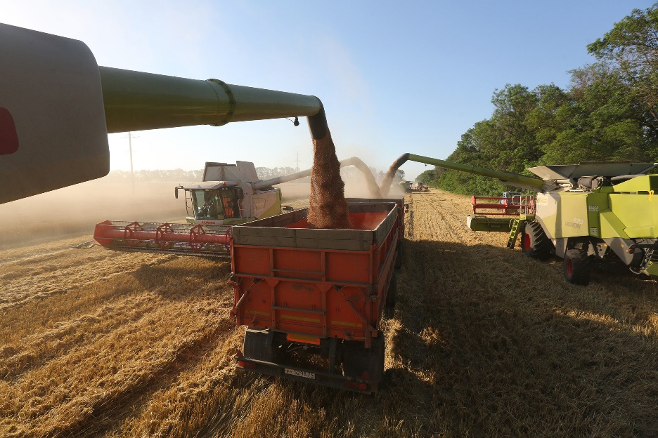
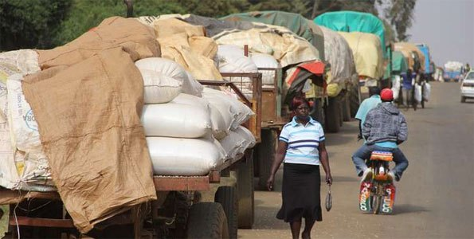
Some examples of how NTMs affect international trade:
TRQs protect more than 50 percent of agricultural production and approximately 43 percent of agricultural trade of developed countries.
Quota allocation: Historical trends, RTA, first come – first served.
Quotas from developing countries remain underfilled.

Slide 22


Domino effects of NTMs (Cotton)
USA – NTM: Subsidies
Cotton subsidy programs had contributed to market distortions, oversupply and resulted in a decline in global cotton prices.
Benin - NTM: price support to farmers

Slide 23
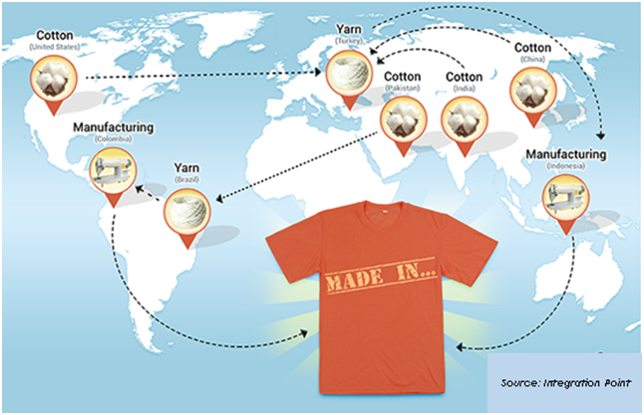
Rules of Origin (Apparel) distort trade
RoO support RTAs and other preferential schemes
Notes:
23

Slide 24


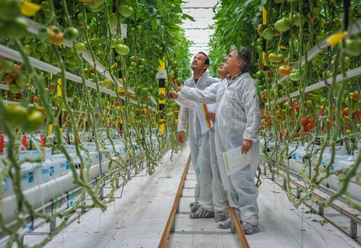
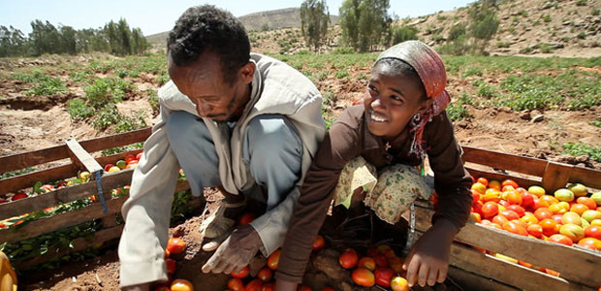
Effects are different for firms and countries: Compliance with Standards: (Tomatoes)

Slide 25
How much NTMs add to the costs of exporting?
Averages may not be high, but costs may be very large in specific products and markets.

Slide 26
Who is more affected?
… low income countries.

Slide 27
NTMs add costs to trade, but are these costs justified? Measures (NTM) vs Barriers (NTB)
Policy | Purpose | Examples | Potential Consequences
NTB Protectionist policies | To help domestic firms and enterprises at the expense of firms in other countries. | Import quotas; local content requirements; public procurement practices | Restrict Trade, Challenges levied at WTO and other trade forums
NTM Assistance policies | To help domestic firms and enterprises, but not at the expense of firms in other countries. | Domestic subsidies; industry bailouts. | Adversely affected countries may respond to protect themselves (i.e.,imposing countervailing duties and subsidies).
NTM Non-protectionist policies | To protect the health and safety of people, animals, and plants; to protect or improve the environment. | Sanitary and phytosanitary (SPS) rules; food, plant and animal inspections; import bans based on objectionable fishing or harvesting methods. | Limited formal consequences lead to efforts to establish common standards or mutual recognition of different standards.

Slide 28
Not all NTM are bad policies
Why is trade regulated by NTMs?
Public policy:
  Protect consumers, environment, development strategy
Domestic/industrial policy:
  Regulate domestic markets (pricing mechanisms)
  Help domestic firms (subsidies)
Trade policy:
  Avoid unintended spillovers (Rules of Origin)
  Favoring some trading partners (Quota allocation)
but also to foster economic interdependency
  need for deeper forms of institutional integration to address distortions affecting trade and investment (common rules, standards)

Slide 29
Policy Implications on the Domestic Economy
Principle of efficient regulations: policy effort is critical to ensure that NTMs serve their intended legitimate purposes.
Efficient regulations are essential for addressing domestic concerns while not decreasing competitiveness (e.g. subsidies should be temporary)
NTMs can have large spillovers and therefore should be precisely targeted to the market failures they are trying to correct (e.g. health protection based on science and not lobbies).
Economic assessment based of Cost (implementation) benefit (purpose) analysis.

Slide 30
Policy implications for trade
Effect on trade once the NTM is in place.
Policy objective: Minimizing the negative effects of NTMs on trade
  Limit negative externalities for trading partners
    RTA Negotiations, limits on policy space.
  Reducing information costs for exporters and importers.
    Increase Transparency of the measures/procedures.
      Notifications, data.
  Reducing trade related costs associated to NTMs
    Trade Facilitations, AfT, Regional chains investments

Slide 31
Some thoughts on trade policy (NTMs) and socio-economic development
Should governments regulate international trade because it creates winners and losers?
The issue a stake is not that a NTMs (trade policy) creates winners and losers.
  A lot of economic policies have redistributive effects.
    Fiscal policy, macroeconomic policies, competition policies.
  Surely there should be mechanisms to soften redistributive effects, but there is no economic reasons why these mechanisms should be integrated into trade policy.
    E.g. Technology displace workers.
      But is efficient to have policies limiting use of technologies?

Slide 32
International Trade and social norms
One better argument is that international trade should be regulated because often results in a violations of social norms embodied in our institutional/national arrangements.
  The suggestion here is that trade may undercut the social bargains struck within a nation and embedded in its laws and regulations.
  Many of these social bargains are related to the SDGs.
    E.g. Decent work, environmental protection.
As now we have some voluntary standards to address those issues (e.g. fair trade, no exploitation of labor), but are enough, or social norms should be enforced by NTMs?

Slide 33
To fix ideas: An example Price dumping vs Social Dumping
PRICE DUMPING
Is reasonable for a company operating in the US to use a supplier from a country where the production of the product (say, steel) is highly subsidized?
Some reasoning:
  Pro trade: Manufacturer have lower costs. Consumers may be paying less for the final product (say Cars).
  Anti trade: However the steel sector in the US may find it not fair to compete with subsidized foreign firms.
  There are NTMs/hard trade rules preventing this dumping.

Slide 34
An example Price dumping vs Social Dumping
SOCIAL DUMPING
Is reasonable for a company operating in the US to use a foreign supplier which employs workers under labor and environmental law that are very different from US laws? (e.g. more lax and no health insurance)?
Some reasoning:
  Pro trade: Consumers may be paying less, and for workers the low income country is better than the alternative.
  Anti trade: However workers in the US may find it not fair, because it goes against the social norms of the US.
As now there is no hard rule preventing this, but should it be?
And if there will rules, be what are the implications for development?

Slide 35
Addressing Social dumping: rewriting trading rules.
NTMs as enforcing mechanisms of socio-economic development. NTMs are getting into Labor provisions.
E.g. US-MEX new deal. M
  Keep gains internal:
    Rules of origin
      75% (from 62.5) auto content
    Wage standards (labor provisions)
      45% of workers should earn at least 16 USD wage
What is the purpose of these 2 provisions?
Keep economic activity and jobs within the RTA.

Slide 36
NTMs in the context of current trade tensions
Trade war is being fought with rounds of retaliatory tariffs, why should we worry about NTMs?
Ultimately, US tariffs on China are in retaliation of forms of NTMs.
  Major US complains:
    Subsidies (State Owned Enterprises)
    Public procurement
    Intellectual Property Rights

Slide 37
Outline
Introduction into Non-Tariff Measures
Non-tariff measures and economic development
NTMs and social and environmental SDGs
What can be done …

Slide 38
UNCTAD-MAST Classification:
The common language
Voluntary standards ✗
Mandatory standards ✓
Multi Agency Support Team
(FAO, IMF, ITC, OECD, UNCTAD, UNIDO,
World Bank, WTO)
initiated by UNCTAD
updated NTM classification

Slide 39
DOWNSIDE:
Average ad-valorem equivalent of NTMs
Not included:
Subsidies/
domestic support
Export restrictions
Source: UNCTAD 2015

Slide 40
DOWNSIDE: costs even higher for…
…developing countries:
  More stringent requirements in developed markets
  Bottlenecks in quality infrastructure
  …
…small and medium-sized companies
  High fixed costs of information
  Lack of capacity to comply with complex measures
  …

Slide 41
DOWNSIDE continued:
Technical NTMs as trade costs…
Trade costs reduce trade opportunities
And therefore reduce trade’s potential to
  generate income
  create employment
  reduce poverty
  create financial resources to promote social and environmental sustainability
“trade – growth nexus” or “export led growth” → only part of the story…

Slide 42
UPSIDE:
Objectives of SPS measures and TBT
SPS measures
  Human, animal and plant health…
    …related to additives, contaminants, toxins, diseases, pests
➔ Legitimate objectives?
TBT measures
  Human health…
    …other that SPS
  Protection of the environment
  National security

Slide 43
UPSIDE:
Direct linkages between NTMs and SDGs
SPS measures and TBT directly impact on sustainability
  food security/safety (SDG 2),
  nutrition and health (SDG 3),
  protect endangered species and the environment (SDGs 14&15),
  ensure sustainable production, consumption (SDG 12) and energy (SDG 7),
  combat climate change (SDG 13).

Slide 44
Some examples
Limits on the use of pesticides ensure safe food → SPS
Fumigation requirement to eliminate pests → SPS
Safe packaging requirements for food → TBT
Restrictions on toxins in toys protect our children → TBT
Emission restrictions for cars → TBT
Seat belt safety requirements → TBT
➔ Keep or eliminate??

Slide 45
What may turn SPS/TBT into "barriers"?
Procedural implementation
Requirement
Lack of transparency/ information costs
Conformity assessment
  Lack of domestic technical infrastructure
  Lack of mutual recognition
  Redundant checks
….
More stringent requirement than international standards
Not science-based
Lack of harmonization of requirements
Discriminatory

Slide 46
What can be done?
Policy coherence and convergence
Coherence:
  SDGs may lead to increased regulatory activity to "directly" regulated sustainability…
  but "indirect" linkages must not be ignored
  Coherent policy making requires that responsible agencies/ministries assess costs and benefits of NTMs
Convergence:
  Harmonization of requirements can reduce trade costs (of adapting products to different market requirements)
  ..while maintaining beneficial sustainability effects
  Convergence and coherence can support each other

Slide 47
Good Regulatory Practice
Advance notification/ consultation of stakeholders and the public
Assessment of potential impacts of future regulation (before issuing regulations)
Evaluation of regulation performance in delivering the intended outcomes (after implementation)
Domestic → Coherence:
  Policy coordination across institutions/ministries is crucial
  Multi-dimensional assessment of costs and benefits
International → Convergence:
  Harmonization
  Equivalence
  Mutual recognition
  Reduce trade costs while maintaining beneficial sustainability effects

Slide 48
Mechanisms at the multilateral level: TBT
Seventh Triennial Review on TBT
  Good Regulatory Practice → as discussed
  Standards → transparency in standard setting
  Conformity Assessment → risk management, mutual recognition
  Technical Assistance → expand, +effectiveness
  Transparency → +notifications, sub-federal level
“Friends of MSMEs” group is proposing increased transparency obligations at WTO MC11
  Notification of final measures, free online publishing of (technical) NTMs, Public consultation
  (trade facilitation, E-commerce, trade finance)

Slide 49
Convergence: towards where?
Level of NTM stringency

Slide 50
Convergence: how? towards where?
International guidelines
e.g. Codex Alimentarius
Level of NTM stringency

Slide 51
Convergence: how? towards where?
Developed markets with differing requirements
International guidelines
e.g. Codex Alimentarius
Level of NTM stringency
REFORM
where?

Slide 52
Convergence: how? towards where?
Developed markets with differing requirements
International guidelines
e.g. Codex Alimentarius
Level of NTM stringency
Regional harmonization promotes intra-regional trade
REFORM
where?

Slide 53
Convergence: how? towards where?
adopting Northern standard as domestic requirement can harm South-South trade
Developed markets with differing requirements
International guidelines
e.g. Codex Alimentarius
Level of NTM stringency
Regional harmonization promotes intra-regional trade
REFORM
where?

Slide 54
Convergence: how? towards where?
adopting Northern standard as domestic requirement can harm South-South trade
Developed markets with differing requirements
International guidelines
e.g. Codex Alimentarius
Level of NTM stringency
Regional harmonization promotes intra-regional trade
adopt international standard to enhance intra- and extra regional trade + sustainability
REFORM
where?

Slide 55

Which international standards?
Source: Presentation by Stanton (WTO)

Slide 56
What to do in RTAs?
Unilateral option: international standards
Bilateral/regional options:
  Harmonization of requirements
  Equivalence of requirements
  Mutual recognition of (different) conformity assessment
  Transparency!
  Good regulatory practice!
  Communication / coordination (e.g. regional committees)!

Slide 57
UNCTAD product:
Regional NTM Integration Review
Research and Analysis
Capacity Building
Research and Analysis
Consensus Building
Component 1
Status quo analysis of NTM-related regional economic integration
→ Political / institutional level
→Technical level
Component 2
NTM data collection and NTM training
→ Collection with national experts and government
→ Training of NTB, SPS, TBT, … focal points
Component 3
Data-based analysis
→ Price impact (“AVEs”)
→ Regulatory distance
→ Welfare impact of NTMs
Component 4
Validation workshop
Support Policy making
.

Slide 58
E.g. ASEAN: Regulatory convergence can reduce impact of technical NTMs by ~25%
Source: UNCTAD and ERIA 2018 (forthcoming)

Slide 59
E.g. UNCTAD analysis for ECOWAS:
Welfare increases in three scenarios
"NTB": intra-regional (only) elimination of barriers
"NTM": "NTB" +
intra-regional regulatory convergence
  (→relatively small impact due to low original intra-regional trade. Still, +14% intra-regional trade.)
"Int.Standards":
"NTB" + "NTM" + adoption of international standards with impact beyond intra-regional trade
  ~1% of GDP (depends..)
Source: UNCTAD and AfDB 2017 (forthcoming)

Slide 60
Conclusions
SPS/TBT measures account for majority of incidence & effect
  But SPS/TBT measures are necessary for sustainable development and affect everyday life (behind the border)
  NTM abroad and at home matter for competitiveness
Reducing the cost of NTMs:
  More transparency is needed
  A simple reform of alignment (without increasing or decreasing measures) could reduce the cost of SPS/TBT in agriculture by 25%
  Using international standards significantly increases gains
Modern FTAs focus on
  transparency and information exchange,
  good regulatory practice and cooperation
  SMEs, cutting red tape

Slide 61
If you want to discuss and learn more
^{MANDATORY REGULATIONS}
^{VOLUNTARY}
^{SUSTAINABILITY}
^{STANDARDS}
Geneva
Palais des Nations
9 – 11 October 2018
UNCTAD.ORG/NTMsweek
Contact:
NTM@UNCTAD.ORG

