Slide 1
UNCTAD’S ROLE IN FACILITATING THE INTEGRATION OF DEVELOPING COUNTRIES IN THE GLOBAL DIGITAL ECONOMY
Cécile Barayre
Economic Affairs Officer, ICT Policy Section
Science, Technology and ICT Branch
Division on Technology and Logistics
2 Mars 2018
P166 SHORT COURSES ON KEY ISSUES ON THE INTERNATIONAL ECONOMIC AGENDA
Assessing the eTrade readiness of the least developed countries for the promotion of sustainable development

Slide 2

From 1999 to UNCTAD 14 and beyond
1999, Building Confidence, First United Nations Report on e-commerce
Strengthened or new UNCTAD activities under the Nairobi Maafikiano
  “Strengthened” work on enhancing development gains from digital economy and e-commerce
  Operationalizing the Intergovernmental Group of Experts on E-commerce and the Digital Economy
Launch of the eTrade for all initiative
“We welcome the formal unveiling of the eTrade for All initiative at UNCTAD XIV. It provides a new approach to trade development through electronic exchanges by allowing developing countries to more easily navigate the supply of technical assistance for building capacity in e-commerce readiness and for donors to get a clear picture of programmes that they could fund.
Nairobi Azimio

Slide 3
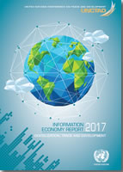
THREE PILLARS – THREE QUESTIONS
Research:
  Information Economy Report
  UNCTAD B2C E-Commerce Index
  Stand alone publication
Consensus build:
  Intergovernmental Group of Experts on e-commerce and the digital economy
  UNCTAD E-commerce Week
Technical cooperation

Slide 4
Digital economy is evolving fast…
Developing economies accounted for nearly 90% of the 750 million people that went online for the first time 2012-2015, India (177 m) China (122m).
Sources: UNCTAD, Cisco, ITU

Slide 5
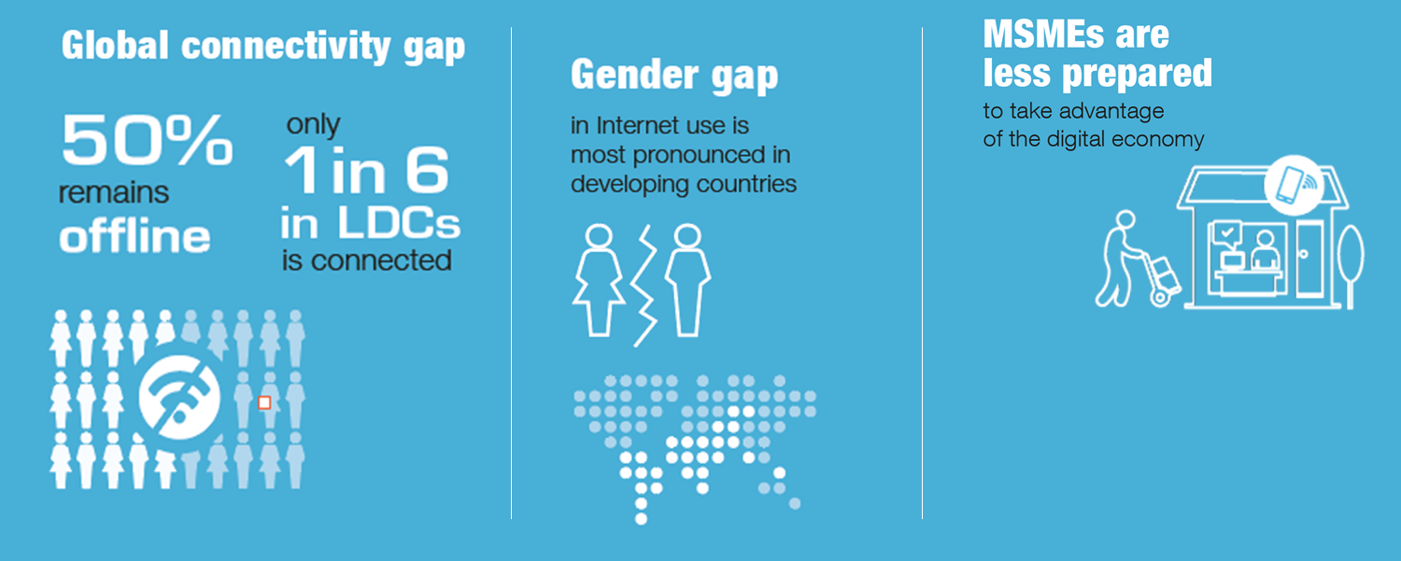
But at different speeds and there are gaps …

Slide 6
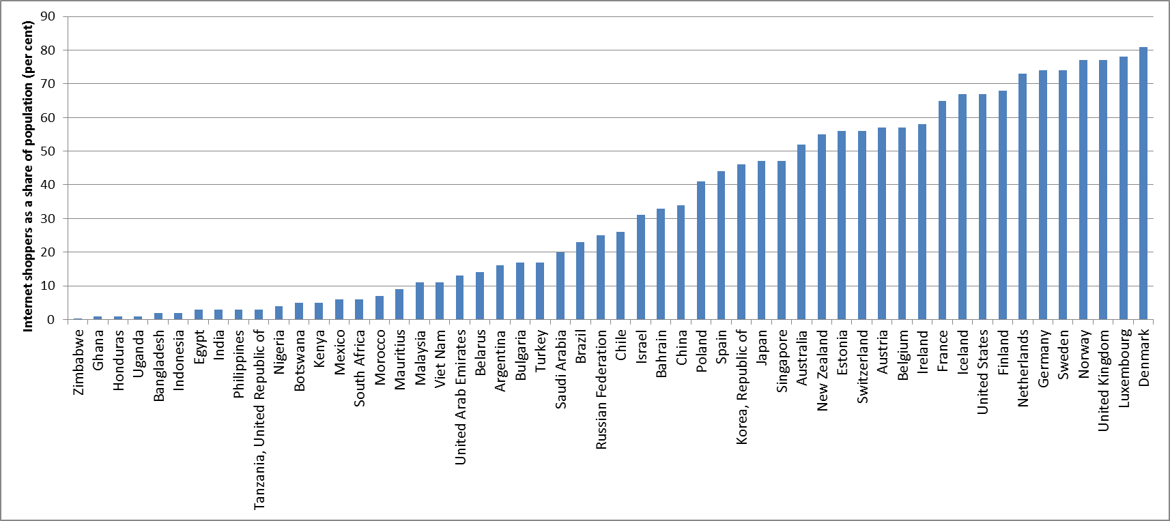
E-commerce Divide is immense
Share of population buying online
Source: UNCTAD

Slide 7
Technical assistance projects
4 Technical Assistance Programmes
  Supported by Germany, the Enhanced Integrated Framework (EIF), Estonia, Finland, Mastercard, United Kingdom, Republic of Korea and Sweden
      E-Commerce and Law Reform (2003)
      Measuring ICT (2004)
      ICT Policy Reviews (2008)
      eTrade for all (July 2016)
      eTrade Readiness Assessments (September 2016)
    RBM Framework in place – first comprehensive at UNCTAD

Slide 8
E-Commerce and Law Reform
Why: establish legal certainty and engender trust & confidence
4 products:
Regional and national capacity-building workshops
  Enhance awareness and skills of policy and law makers and the judiciary
  Work together to understand the issues and learn from good practices
  Trainees become promoters of the reform process
Law revision and preparation of regional cyberlaw frameworks
Regional Cyberlaw studies
Cyberlaw tracker : unctad.org/cyberlawtracker.org

Slide 9
Legal and Regulatory Frameworks
Global Situation and next challenges
PLEASE RESPOND TO OUR 2018 SURVEY
Source: UNCTAD

Slide 10
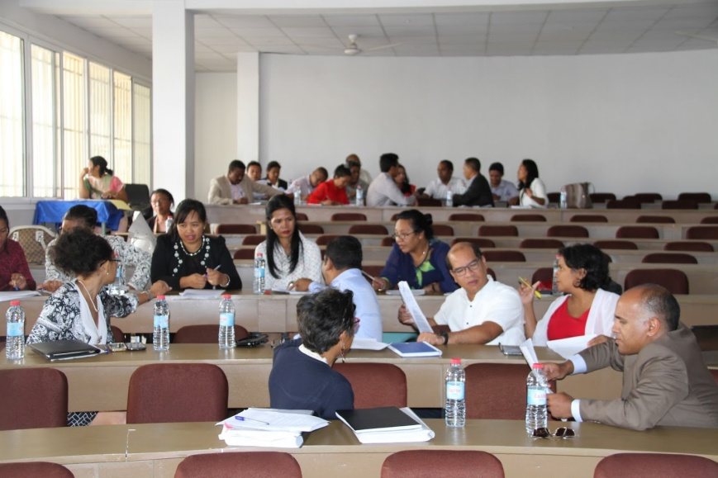
E-Commerce and Law Reform
Geographical coverage so far:
27 LDCs (Africa: 21 countries - ECOWAS, EAC, Madagascar; Asia: Cambodia, Lao PDR and Myanmar; Pacific: Samoa, Vanuatu, Solomon Islands)
Asia: ASEAN member countries
Latin America and the Caribbean: 33 countries
Over 3,000 policy and law makers have been trained through more than 30 online and face-to-face workshops
Upcoming in APRIL:
    Launch of the Comparative study on e-commerce legislation in the Caribbean (2018)
    Update on the cyberlawtracker (April 2018)

Slide 11
Measuring the Information Economy
Relevant data essential for evidence-based policy making
Technical assistance to boost the capacity of national statistical systems to produce internationally comparable ICT indicators
  Advisory missions
  Regional training courses - build regional networks of ICT statisticians
  Training of trainers
  Training material
Data collection and publication: annual UNCTAD survey sent to all national statistical offices: unctadstat.unctad.org
Swedish International Development Cooperation Agency has supported UNCTAD and the Partnership in this area

Slide 12














Partnership on Measuring ICT4D
Started in 2004, at UNCTAD XI in Sao Paulo
To improve the availability and quality of ICT data and indicators to inform policy makers
How: by building consensus on common methodologies for core indicators

Slide 13
Focus on Information Economy
Core indicators
  12 indicators on ICT access and use by enterprises (B1 to B12)
  2 indicators on the ICT producing sector (ICT1 and ICT2)
  2 indicators on international trade in ICT goods (ICT3 and ICT4)
  Ongoing work on trade in ICT services and in ICT-enabled services
  Endorsed by the UN Statistical Commission
UNCTAD Manual: definitions, standards, model questions
  Manual for the production of statistics on the information economy
  Training material
Building regional networks of experts
  Regional Workshop for Asia-Pacific LDCs on Information Economy Statistics, 14-18 March 2016, Bangkok: attended by NSO professionals from Afghanistan, Bangladesh, Bhutan, Cambodia, Kiribati, Laos, Myanmar, Nepal, Timor-Leste, Tuvalu and Vanuatu

Slide 14

E-commerce Strategy Development
National E-Commerce Strategy of Egypt
In progress: Rwanda and Oman
In pipeline: Botswana, Kenya
Objectives:
  To improve policy and institutional framework to benefit more from e-commerce, in particular among MSMEs
  To support e-commerce adoption by consumers and firms
  To promote the development of services, infrastructure and an enabling environment that will support e-commerce
  To leverage e-commerce to promote exports and cross-border trade
  To promote greater development gains, by fostering of economic growth, generating revenue and creating jobs

Slide 15
Purpose and scope of eTrade for all
Multi-stakeholder initiative to achieve significant improvements in the ability of countries to use and benefit from e-commerce by:
  raising awareness of countries' unique opportunities, challenges and constraints to e-commerce;
  mobilizing and rationalizing available financial and human resources for the implementation of projects that would address those challenges and constraints; and
  strengthening coherence and synergies among partner activities to further the use and gains from e-commerce in developing countries.

Slide 16
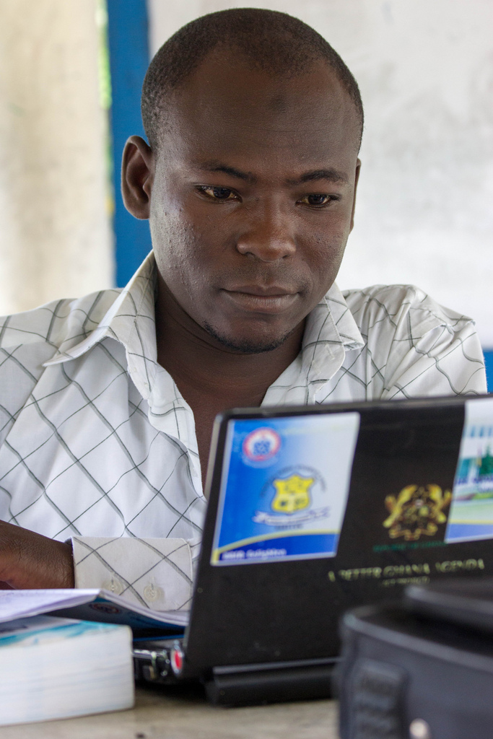

Connecting the dots among partners and beneficiaries to reap e-commerce gains
African Development Bank
Economic Commission for Africa
Economic Commission for Latin America and the Caribbean
Enhanced Integrated Framework
E-Residency (Estonia)
Inter-American Development Bank
International Association of Prosecutors
International Civil Aviation Organization
International Islamic Trade Finance Corporation
International Telecommunications Union
International Trade Centre
Internet Society
United Nations Commission on Trade Law
United Nations Conference on Trade and Development
United Nations Economic Commission for Europe
United Nations Commission for Latin America and the Carribean
United Nations Economic and Social Commission for Asia and the Pacific
United Nations Economic Commission for Western Africa
United Nations Social Impact Fund
UNIDO
Universal Postal Union
World Bank Group
World Customs Organization
World Intellectual Prperty Organization
World Trade Organization
African Alliance for E-commerce
Alibaba
Bangladesh Association of Software and Information Services
Bizisol
Burundishop
DHL
eBay
einstituto.org
Etsy
Fedex
Fiata.com
First Atlantic Commerce
Google
Huawei
Impact Enterprises
International Council of Swedish Industry
Kapruka and Grasshopper
King and Spalding
Latin American eCommerce Institute
Nextrade Group
PayPal
RingierAfrica
TCS Express & Logistics
UPS
vTex
World Information Technology and Services Alliance
World SME Forum
E-commerce readiness assessment and strategy formulation
ICT infrastructure and services
Payment solutions
Trade logistics and trade facilitation
Legal and regulatory frameworks
E-commerce skills development
Access to financing
1
platform
193 potential beneficiaries
+30
private sector members
28
partners
7
policy areas

Slide 17
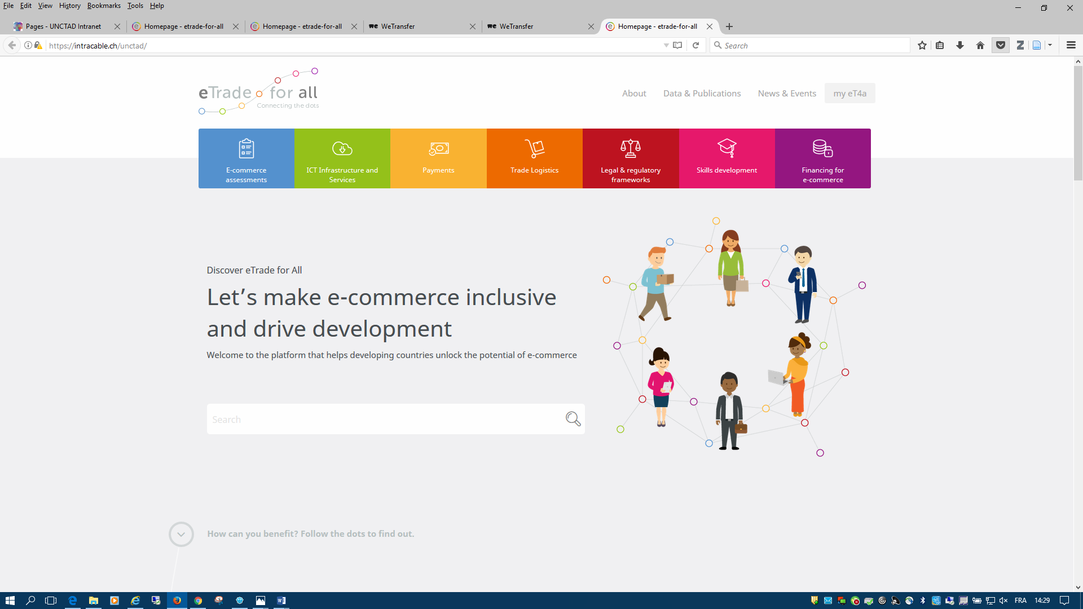
Assistance by other organizations check out etradeforall.org

Slide 18

What can you find on it?
Development solutions
partner offers under the 7 policy areas
Stories
share & learn among beneficiaries and partners
Interactive calendar
upcoming and past events, news
Data
e-commerce data, indicators, research
…New functionalities soon to be released
E-Commerce Week 2018

Slide 19
Rapid eTrade Readiness Assessments
Essential step for developing countries to raise awareness of e-commerce opportunities and challenges
Assessments can serve as basis for policies to harness the development potential of e-commerce
Focus on seven key policy areas of eTrade for all
In each area, readiness gaps are identified that can be addressed through public and private partnerships
Lao PDR, Liberia and Myanmar; Senegal, Solomon Islands and Vanuatu
Requests: Afghanistan, Bangladesh, Burundi, Lesotho, Nuie, Malawi, Tanzania, Togo, Uganda, Zambia

Slide 20
Save the date!
E-COMMERCE WEEK 2018 16-20 APRIL in GENEVA
Second session of the UNCTAD Intergovernmental Group of Experts (IGE) on E-commerce and the Digital Economy
Key facts
5 day-event including
a 3-day dedicated meetings of experts (IGE 2018) on leveraging platforms and digital entrepreneurship for development
1 High-Level conversation, eTrade for all private partners meeting, networking opportunities … and much more…
More than
1'000 participants
in 2017
Notes:
As decided at the first session

Slide 21

E-Commerce Week Highlights
2 Ministerial Roundtables: SDGS & Gender
1 High-level Dialogue
40+ sessions
Launch of Rapid eTrade Assessments:
  Lao PDR
  Liberia
  Myanmar
New data on Internet user perceptions
Sharing Economy – Learnings from China
Towards an ASEAN E-commerce Agreement
Egypt e-commerce strategy
E-commerce in Africa
Measuring digital trade
Block-chain, trade and development
First global meeting of e-commerce associations
Consumer protection online
Building digital skills
Regional development banks
Update of the cyberlawtracker
…and much more

Slide 22
Second session of UNCTAD IGE
Discussion topics and guiding questions
  How can developing countries foster local platforms for domestic and cross-border e-commerce?
  What are the existing barriers related to international e-commerce platforms that developing countries, including the least developed countries, face and how can these barriers be overcome?
  What are some of the operational constraints that small and medium-sized businesses in developing countries face when setting up trade online, and how can they be overcome?
  What are the good practices that developed and developing countries, including the least developed countries, can learn from each other?
Notes:
As decided at the first session

Slide 23
« Savoir où l'on veut aller, c'est très bien ;
mais il faut encore montrer qu'on y va. »
Emile Zola

Slide 24
Thank you for your attention!

