Slide 1
Assessing the progress of LDCs in achieving the Sustainable Development Goals
GIOVANNI VALENSISI
Division for Africa, Least Developed Countries and Special Programmes – UNCTAD
Short courses for Permanent Missions in Geneva
13 April 2018

Slide 2
Conceptual starting point
Contribution to UN efforts to monitor the implementation of Agenda 2030 for Sustainable Development in relation to LDCs and UNCTAD’s mandate
“We will strengthen the productive capacities of least-developed countries in all sectors, including through structural transformation” (Para 27 of the 2030 Agenda for SD)
Focus on the international dimension, consistently with para 3 of the Nairobi Maafikiano: “while each country has primary responsibility for its own economic and social development, the support of an enabling international environment is integral to the success of national efforts”

Slide 3
Outline of the presentation
Economic growth & structural transformation
International trade
Resource mobilization
Outlook and policy implications

Slide 4
Economic growth & structural transformation
Ten years after the global financial crisis, the world economy is picking up but not lifting off
After the 2016 global slowdown, worldwide trade flows witnessed a modest but accelerating rebound (+4% in volume in ¾ of 2017)
In 2016 LDCs posted their lowest real GDP growth rate since the year 2000: 3.8%

Slide 5
Economic growth & structural transformation
Anaemic recovery of developed economies stifled by austerity & unresolved inequality
Slow-down of ODCs (+ strategic reorientation of systemically-relevant economies)
Heightened uncertainty
Idiosyncratic factors (eg. conflicts)
Generalized growth slowdown in LDCs (esp. in Africa)
Large ToT shocks for commodity-dependent LDCs (esp. fuel-exporters)
GDP p.c. divergence between LDCs and ODCs actually widened since 2009 (only few LDCs catching up)

Slide 6
Economic growth & structural transformation
In 2017 only 5 LDCs met SDG (and IPoA) target 8.1: Bangladesh, Djibouti, Ethiopia, Myanmar, Nepal.
Conversely real GDP p.c. declined in 9 other LDCs

Slide 7
Economic growth & structural transformation
Contrary to SDG target 9.2, more than half of the LDCs display a shrinking of the industrial sector’s weight between 2006 and 2016, including nearly all the LDCs where agriculture increased its share of GDP.

Slide 8
Economic growth & structural transformation
If nearly all LDCs witnessed an expansion of manufacturing value added (MVA) between 2006 and 2016, this was often accompanied by “relative de-industrialization” (↓ manufacturing share of GDP)

Slide 9
International trade
LDC exports in 2016 totaled $190bln, with 3rd consecutive decline from 2013 peak; imports contracted even more reaching $287 bln.
Since IPoA adoption, prospects to achieve the target of doubling LDCs’ share of global exports (SDG 17.11) have been missed
The stalemate on the Doha round (also in the SDGs) and the risks of renewed protectionism only add a further policy uncertainties

Slide 10
International trade
The tepid recovery of world trade coupled with modest pickup of commodity prices is unlikely to reverse LDCs’ marginalization.

Slide 11
International trade
The decline in commodity prices somewhat reduced their weight in LDC merchandise export basket, but they account for 2/3 of the total (even more for many African LDCs)
Imports, conversely, remain highly skewed towards manufactures (incl. capital goods), and sensitive imports such as food and fuels

Slide 12
International trade
Trade volumes went up, but more for imports than for exports.

Slide 13
International trade
The lopsided pattern of specialization is coupled with structural current acc. deficits (on avg. -9% of GDP): in 2017 this was the case for 44 LDCs, the exceptions being large recipient of ODA or remittances
Moreover, deficits are expected to widen, putting more pressure on BoP

Slide 14
Resource mobilization
National account identities imply that
S - I = Exp - Imp
& this relationship links capital formation to current account.
LDCs have managed to keep GFCF > 25% of GDP (as per BPoA target), but in the aftermath of the crisis this has entailed a heightened reliance on external financial resource

Slide 15
Resource mobilization
In 2016 LDCs accounted for 2.2 % of global FDI ($ 38 bln)
Concentrated in few (resource-rich or large dynamic) LDCs: top-5 recipient ≈ 66% of the total, but important also for smaller economies
Key issues: linkages to the domestic ec. & technology transfer

Slide 16
Resource mobilization
Remittances to LDCs totaled $ 37bln in 2017 (7% of world tot), with a slight decline compared to the previous year.
Remittances inflows remain concentrated to few recipient LDCs, but their relevance is critical also for smaller economies (SIDS)

Slide 17
Resource mobilization
2000-2016
Though its importance is declining (esp. for large ec.), ODA remains a key source of external finance for a number of LDCs
Preliminary OECD data for 2017 suggest a 4% increase in DAC donors net bilateral ODA to LDCs

Slide 18
Resource mobilization
Only a handful of donor countries are meeting the IPoA and SDG 17.2 aid target of 0.15-0.20% of GNI (first adopted in 1981!)
Had donor countries delivered on their pledges, LDCs would have received additional $32-53 bln
Questionable whether sectoral aid allocation reflects LDCs policy priorities (eg. in 2015 >2% of total ODA went to LDC energy sector)

Slide 19
Resource mobilization
After the “good years” following HIPC & MDRI initiatives, levels of indebtedness in LDCs have climbed up again
Between 2014-2016, debt stocks for median LDC increased from 26 to 28 percent of GDP, while debt service rose by 25%

Slide 20
Resource mobilization

Slide 21
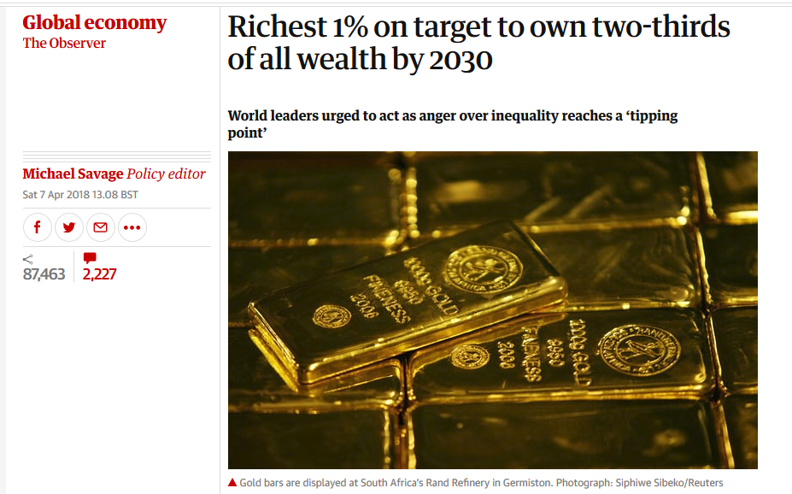
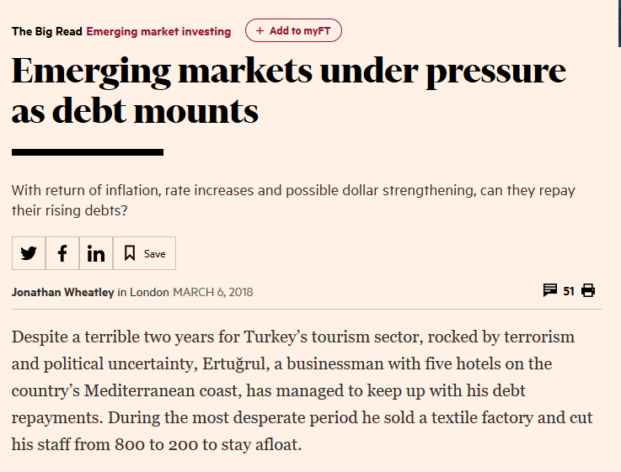
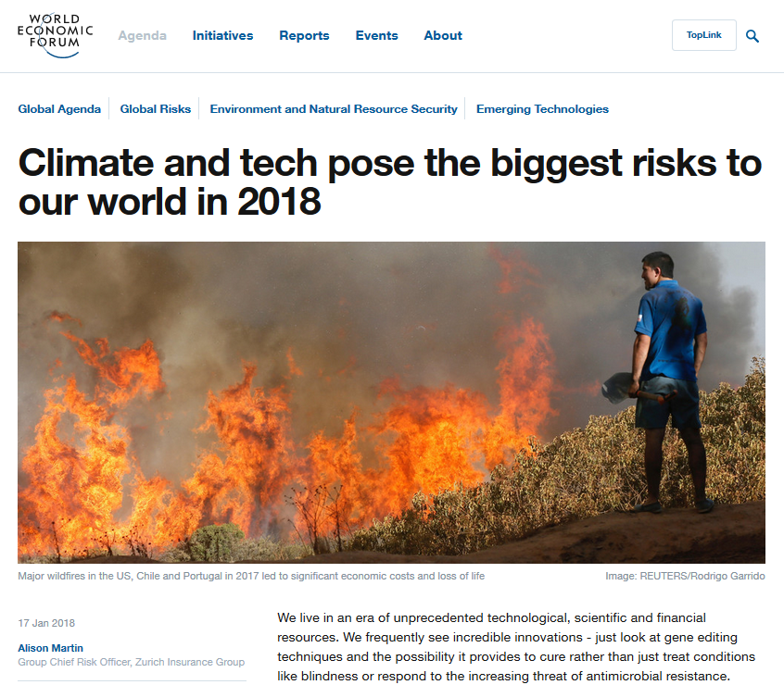
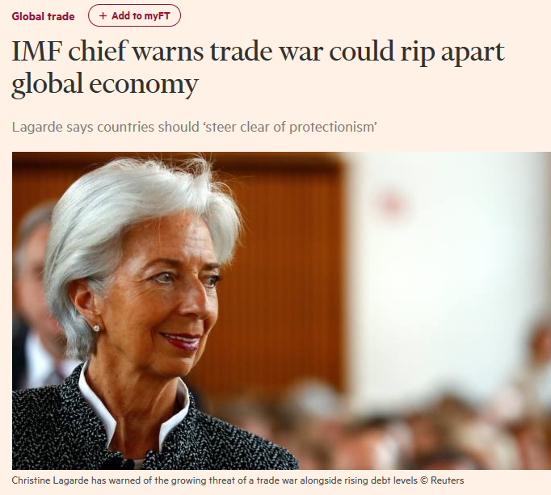
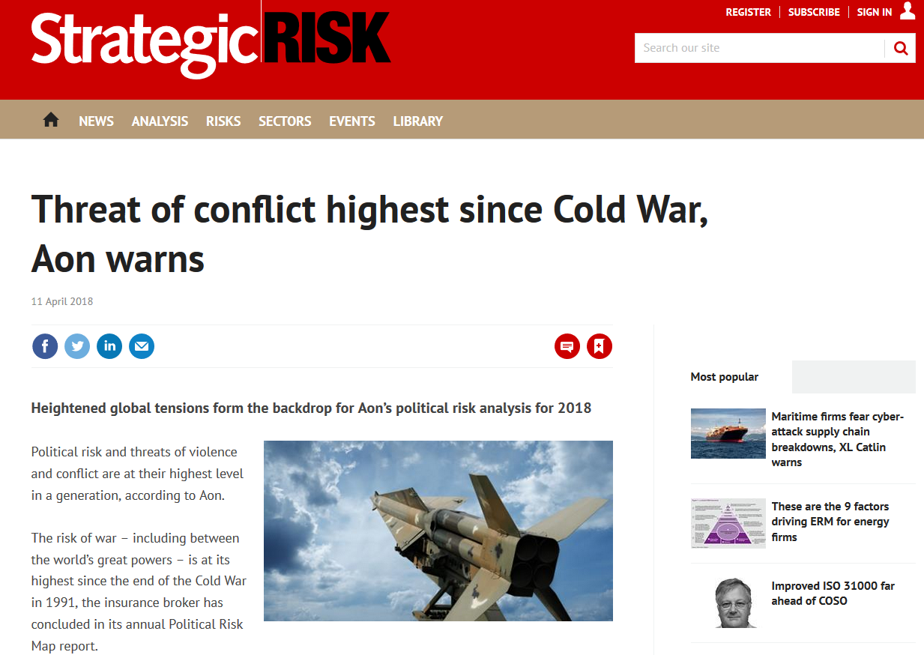
Outlook and policy implications
Global growth is expected to strengthen in 2018, but will likely fall short of the robust expansion needed to boost LDCs performance
Some root-causes of the crisis remain largely unaddressed (heightened inequality, financial instability)
Meanwhile significant downside risks loom

Slide 22
Outlook and policy implications
GDP growth for LDC is expected to touch 5.5%, but most countries will struggle to re-embark on a sustained growth trajectory implied by the Sustainable Development Goals
Given the pace of the global recovery and of the pickup in commodity prices, LDCs remain unlikely to find in international trade a decisive solution to their growth slowdown
Maintaining levels of investments will be critical to ensure continued progress towards building productive capacities
As most LDCs are expected to continue facing current account deficits, external financing requirements remain a critical challenge ( → financial shocks & indebtedness)

Slide 23
Outlook and policy implications
Similar prospects make it all the more imperative for the international community to embark a “global new deal”, capable of delivering inclusive growth worldwide
The ongoing tepid recovery alone is unlikely to provide sufficient support for most LDCs to reverse their long-standing marginalization and income divergence
Redressing widening global inequalities and leaving no one behind requires meeting long-standing commitments to LDCs, and matching the level of ambition of the SDGs with a corresponding enhancement of ISMs.
Italso entails renewed concerted efforts to address systemic issues of interest to both LDCs & ODCs, incl. debt restructuring mechanism (17.4), IFF (16.4), & climate finance (13.a)

Slide 24
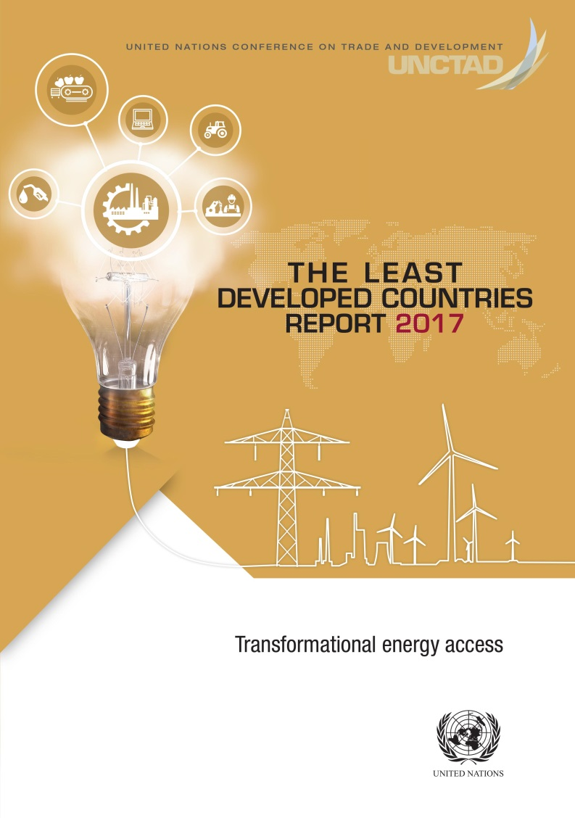
Thank you

