Slide 1

P166 Short Course
Recent developments in international trade and their implications for the policymaking process
1st session
May 4th 2018, Geneva
Alessandro Nicita
Trade Analysis Branch
Division on International Trade and Commodities
UNCTAD
Notes:
1

Slide 2
Outline 1st session
1. Global trends in Trade
2. South-South Trade
3. Trade Policy
4. Trade Imbalances
5. Trade Wars
6. Implications for SDGs

Slide 4
International trade and global output
Globalization Crisis Rebound/Globalization Cris. Reb. Stagnation de-Gl. Rebound?

Slide 5
De-globalization 2015-2016

Slide 6
2017 – End of De-globalization?

Slide 7
What to expect for 2018?
Cyclical factors -> contributing to trade growth
  Commodities cycle, economic growth
Changes in structural factors not helping
  Geopolitical tensions
  Global economy fragile, uncertainty
  Continuing reshoring
  Trend towards restrictive trade policies

Slide 8
2. Trends in South-South Trade

Slide 9
South-South trade
Geographic decomposition

Slide 10
South-South trade,
Average km for exported goods changes 2006-2016
Blue/green = relative increase in trade with far away countries
Red/orange = relative increase in trade with closer countries

Slide 11
South-South trade - Main points
South-South trade is not outperforming the rest
South-South remains largely about East Asia and China
Latin America regional trade dis-integration
Large potential for intra Africa trade
  But which outcome? East Asia or Latin America

Slide 12
3. Trade Policies
Tariffs
Non-Tariff Measures
Trade Agreements

Slide 13
Tariffs remain low, on average

Slide 14
But a lot of tariffs are still there

Slide 15
Non-tariff Measures
A lot of regulations to comply with
Trade tensions on the rise

Slide 16
Tariffs and NTMs, by sector

Slide 17
Trade Agreements
Deep trade agreement on the rise, but what is next?

Slide 18
Trade policy - Main points
Tariffs generally low, but not always so.
NTMs increasingly affect world trade
  Result in distortions that often are not in favor of low income countries.
  Contributing to Polarization
Trade Agreements
  Trends towards bilateralism, renegotiations
  Developing countries (deep/shallow)

Slide 19
4. Unbalanced trade

Slide 20
Major Imbalances

Slide 21
Causes of trade imbalances
Economic returns
  Investment flows
Macroeconomic policies
  Tax, interest, exchange rates
  Quantitative easing, money supply
Cultural, demographic patterns
  Savings and consumption rates
Trade policy
  Short term impact
  Influences mainly bilateral trade imbalances, but not overall.
Trade balances are very bad indicators of economic performance

Slide 22
Trade deficits: good or bad?
It depends. What are the underlining causes?
  a country that attracts more inward investment from foreigners than it invests abroad must run a trade deficit.
  Are investment flows productive, or just fuel consumption?
Trade deficits are crisis waiting to happen?
  Sustainability and Vulnerability

Slide 23
Sustainability
Trade balances as % of GDP

Slide 24
Vulnerability to capital flights
Number of years in deficit/surplus since 2006

Slide 25
Trade tensions: US bilateral Balances

Slide 26
5. Trade wars
What is a trade war? Series of retaliatory actions
  Fought with trade policy (Tariffs, Quotas, VARs, NTMs)
  Hard to de-escalate, incentives to retaliate becomes larger
Arguments for resisting a trade war
  Political economy (export lobbies, GVC)
  Multilateral cooperation in other areas
  Fear of Retaliation
Arguments for escalating a trade war
  Economic: Unilateral optimal tariffs – Market power
  Tariffs reduce international prices, thus more protection asked elsewhere
  Political economy (import competition lobbies)

Slide 27
Trade wars, what tariffs?
Unilateral Optimal tariffs faced without WTO/PTA

Slide 28
Outcomes of trade wars
Winners and losers of a trade war
  Adjustment costs, nobody really wins but probably a few sectors/industries with lobby power
    Impact on capital / labor?
Implications for developing countries
  Maybe some short term gains (trade diversion)
  Most countries are price takers, lower export prices.
  Caught in the cross-fire of rising tariffs
    Taking sides?
    Trade wars may have no exceptions, no SDT to avoid triangulation
  Most likely deterioration of market access conditions
Implications for WTO, multilateral cooperation
  Wars increase incentives to move out of the WTO framework

Slide 29
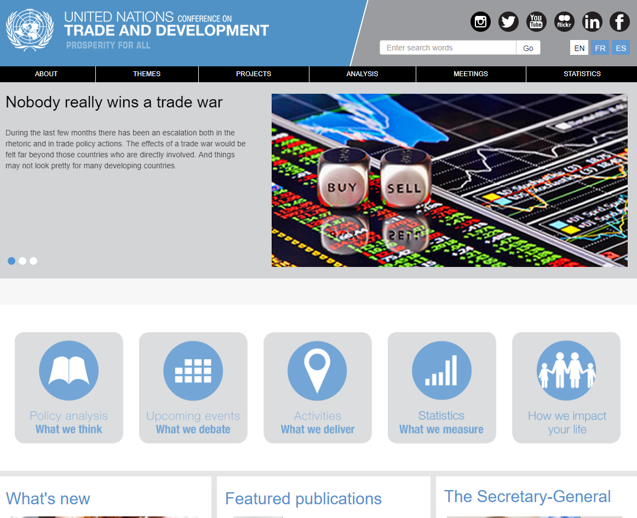

Slide 30
Trade in the SDGs
Trade is explicitly a target for SDG 17
  Partnership, Multilateral cooperation
    Doubling LDCs exports may be difficult in the present environment
but trade / trade policies mentioned also for other goals, for example:
Goal 8 (decent work and economic growth) …Aid for Trade support for developing countries, especially for the least developed countries
Goal 9 (industry, innovation and infrastructure) notes the need for …regional and trans-border infrastructure and increasing the integration of small-scale industrial and other enterprises into international value chains.
Goal 10 (reducing inequality) emphasizes the importance of special and differential treatment for developing countries, in accordance with World Trade Organization (WTO) agreements.
and because economic growth and efficiency gains trade is relevant for all SDGs.

Slide 31
Implications for the SDGs
International Trade
  The size of the pie may not be increasing as much as in the past, or at all.
  Effect on Aid-for-trade, development assistance programs, etc
  Implications for the success of trade integration strategies and consequently for availability of resources to achieve the SDGs.
Trade policy
  Use of trade policy instruments to achieve not only commercial goals but possibly also issues related to some sustainable development objectives (environmental standards, labor standards - inequality).
  For real? Good for SDGs. Protectionism in disguise, Bad for SDGs.
Multilateral cooperation
  WTO could quickly lose legitimacy/authority because of trade tensions.
  Trade tensions further alienate parties and distract from other SDGs related issues where multilateral cooperation is essential.

Slide 32
Alessandro Nicita
E-mail: alessandro.nicita@unctad.org
Tel: +41 22 917 5685
Thank you.
32

